Slide 1
6-Axis Force Sensing in Robotic Minimally Invasive Surgery With No Instrument Modification

Slide 2
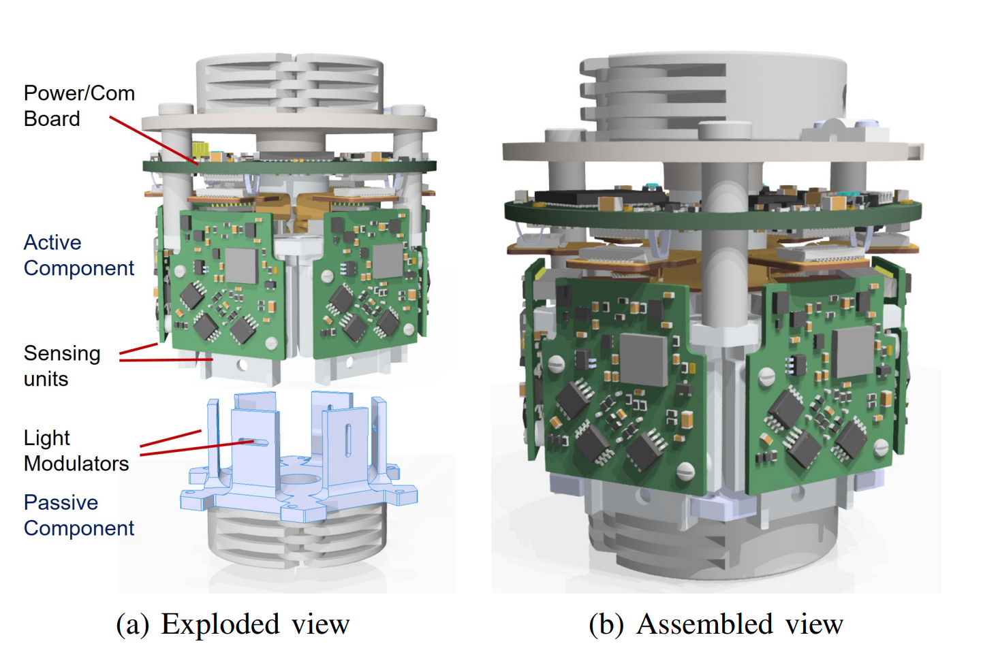
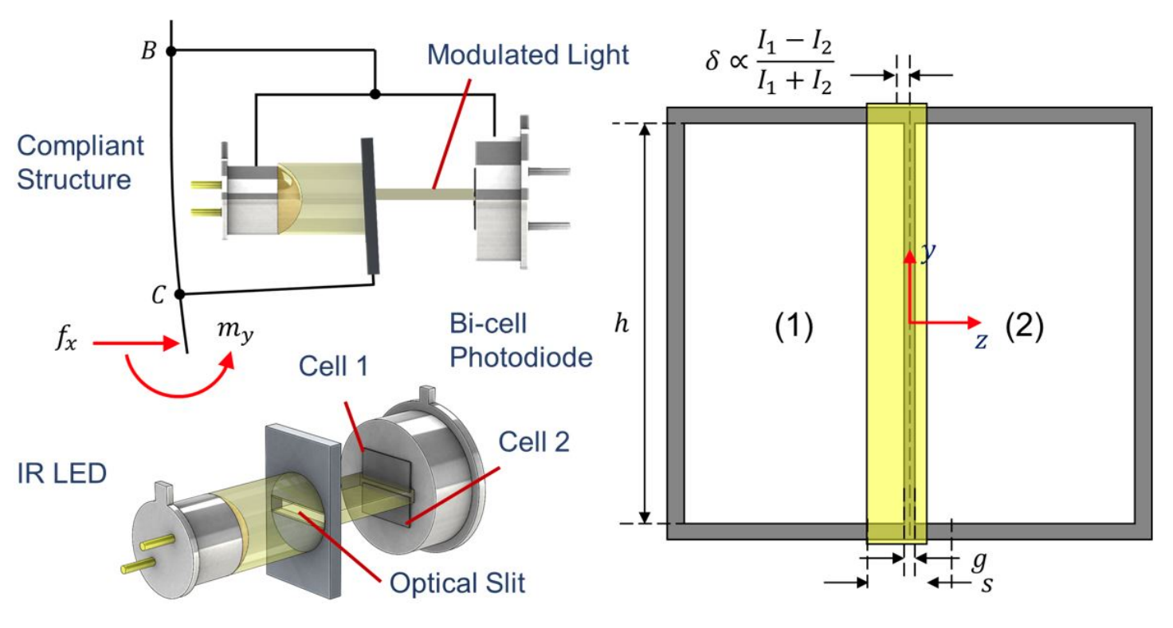
Transducer

Slide 3
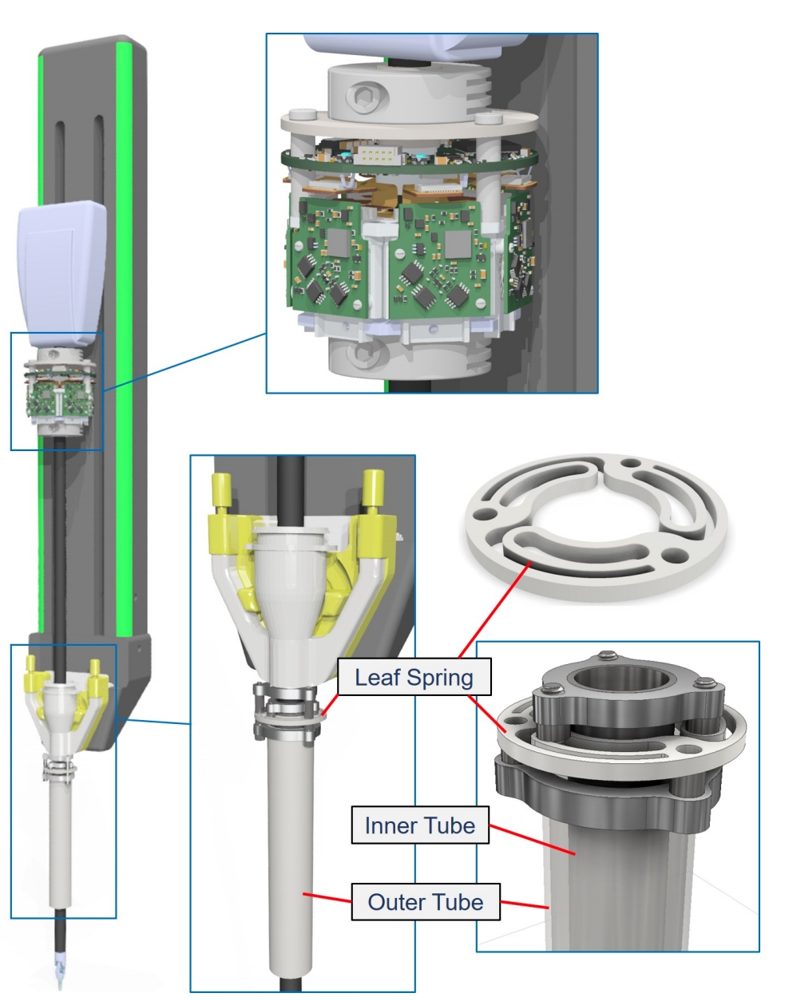
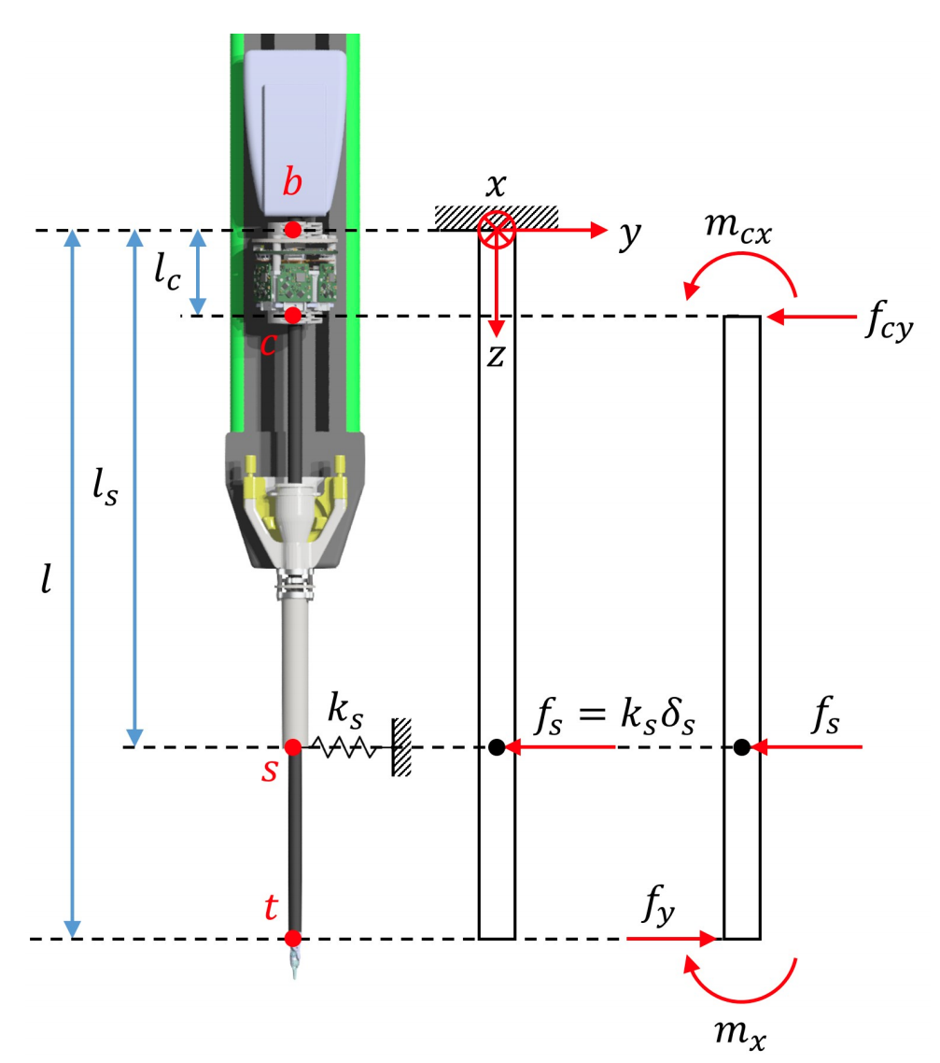
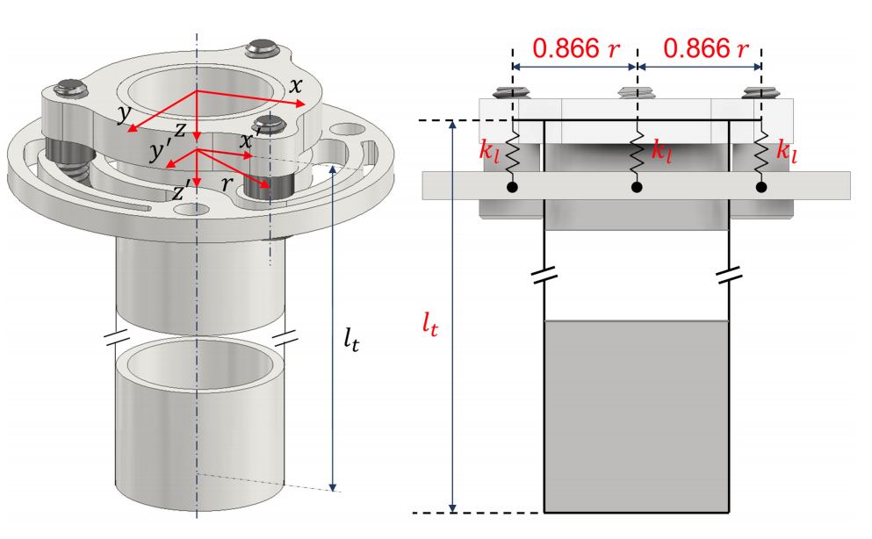
Modeling

Slide 4
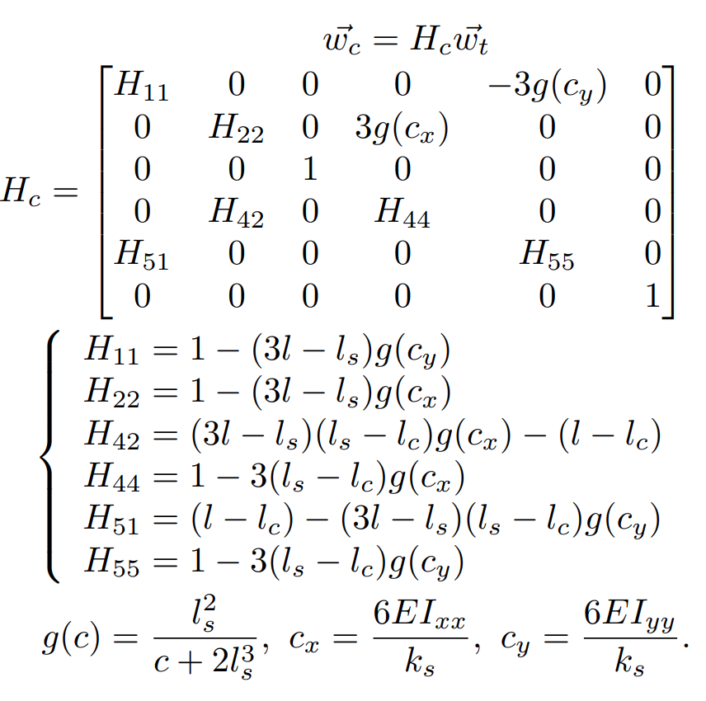
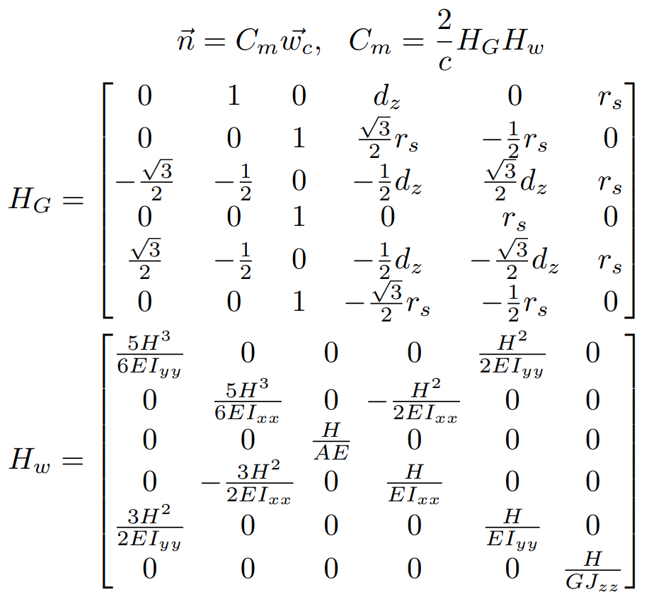
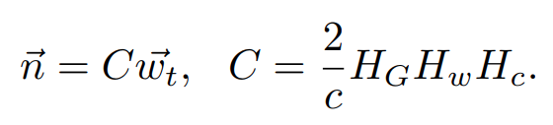
Modeling

Slide 5
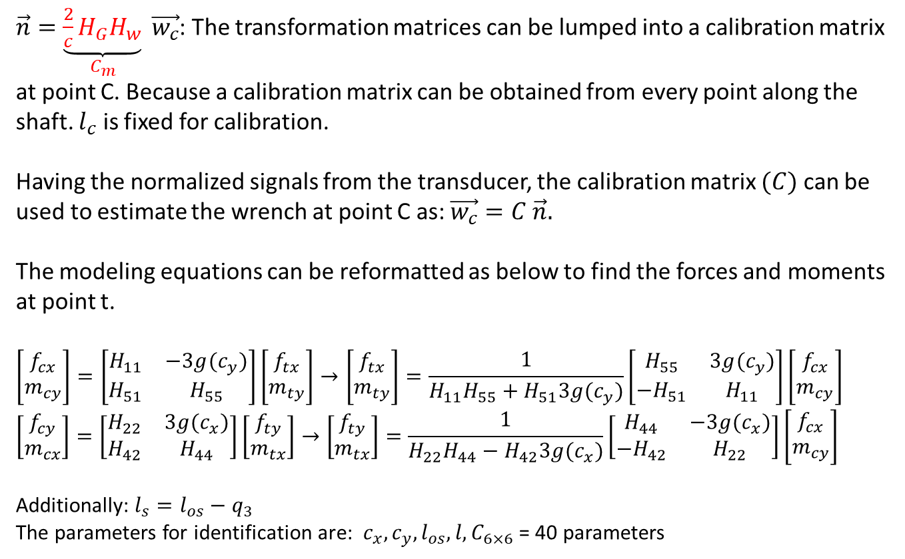
Calibration
$\vec{n}=\underset{C_{m}}{\underbrace{\frac{2}{c}H_{G}H_{w}}} \vec{w_{c}}$: The transformation matrices can be lumped into a calibration matrix at point C. Because a calibration matrix can be obtained from every point along the shaft. $l_{c}$ is fixed for calibration.
Having the normalized signals from the transducer, the calibration matrix $(C)$ can be used to estimate the wrench at point C as: $\vec{w_{c}}=C \vec{n}.$
The modeling equations can be reformatted as below to find the forces and moments at point t.
$$\left[\begin{aligned}f_{cx} \\ m_{cy}\end{aligned}\right]=\left[\begin{matrix}H_{11} & −3g(c_{y}) \\ H_{51} & H_{55}\end{matrix}\right]\left[\begin{aligned}f_{tx} \\ m_{ty}\end{aligned}\right]→\left[\begin{aligned}f_{tx} \\ m_{ty}\end{aligned}\right]=\frac{1}{H_{11}H_{55}+H_{51}3g(c_{y})}\left[\begin{matrix}H_{55} & 3g(c_{y}) \\ −H_{51} & H_{11}\end{matrix}\right]\left[\begin{aligned}f_{cx} \\ m_{cy}\end{aligned}\right]$$
$$\left[\begin{aligned}f_{cy} \\ m_{cx}\end{aligned}\right]=\left[\begin{matrix}H_{22} & 3g(c_{x}) \\ H_{42} & H_{44}\end{matrix}\right]\left[\begin{aligned}f_{ty} \\ m_{tx}\end{aligned}\right]→\left[\begin{aligned}f_{ty} \\ m_{tx}\end{aligned}\right]=\frac{1}{H_{22}H_{44}−H_{42}3g(c_{x})}\left[\begin{matrix}H_{44} & −3g(c_{x}) \\ −H_{42} & H_{22}\end{matrix}\right]\left[\begin{aligned}f_{cx} \\ m_{cy}\end{aligned}\right]$$
Additionally: $l_{s}=l_{os}−q_{3}$
The parameters for identification are: $c_{x},c_{y}, l_{os}, l, C_{6×6}$ = 40 parameters

Slide 6
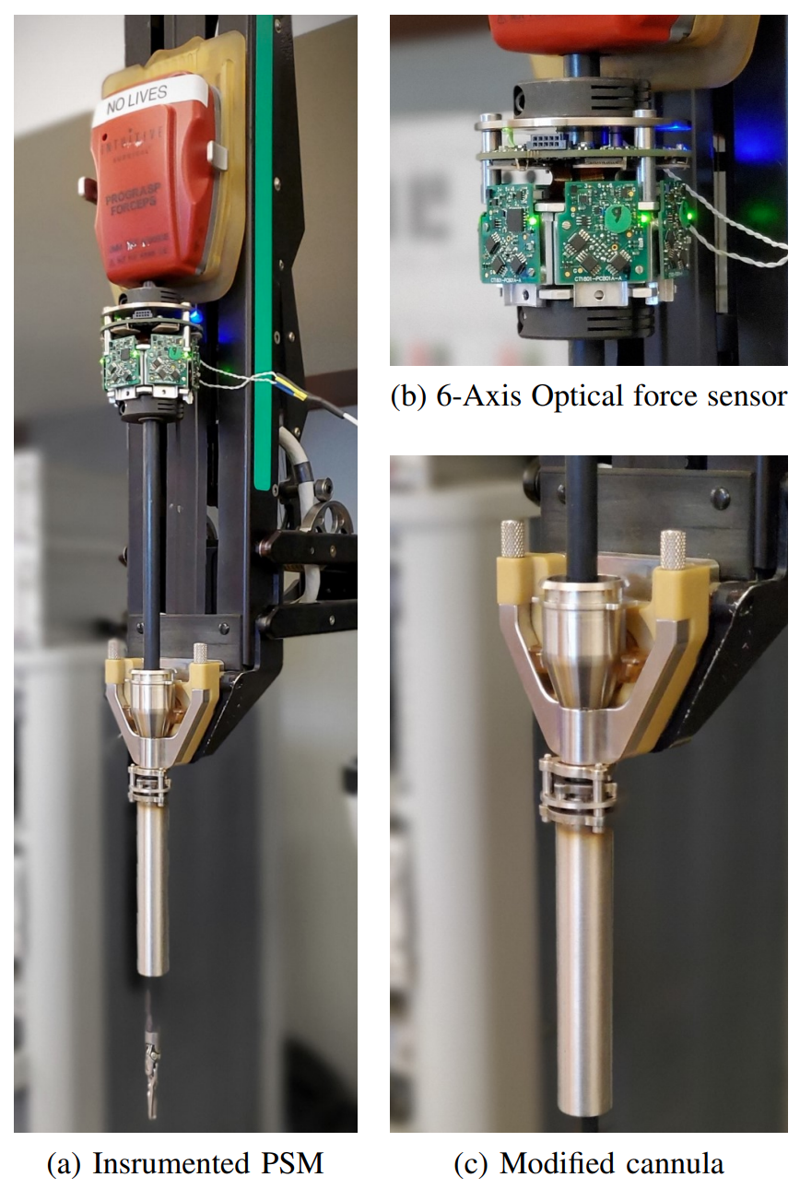
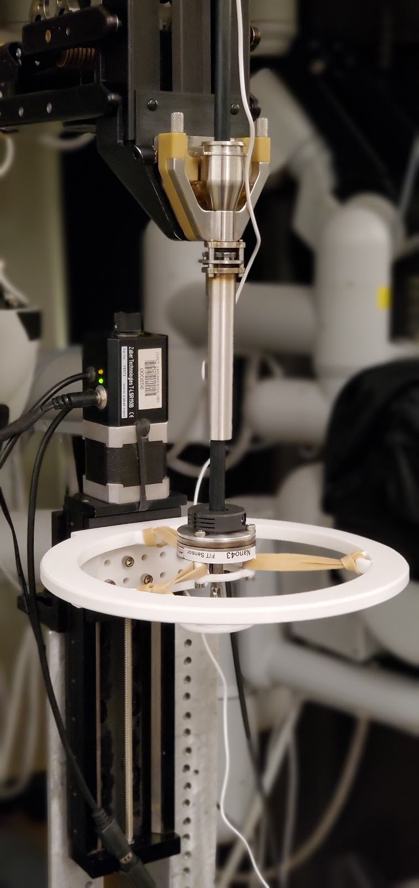
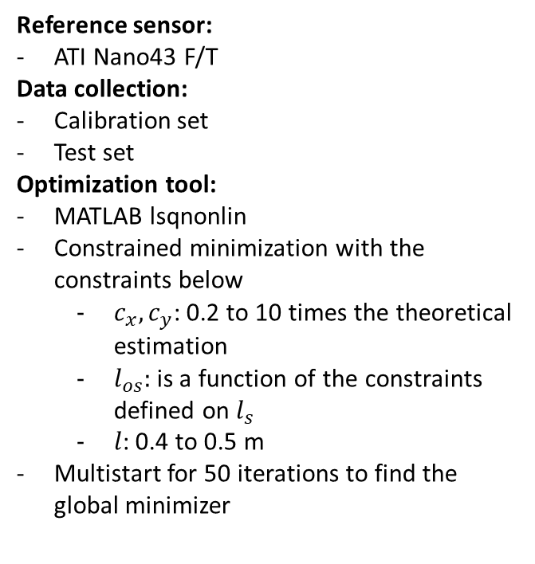
Calibration
Reference sensor:
ATI Nano43 F/T
Data collection:
Calibration set
Test set
Optimization tool:
MATLAB lsqnonlin
Constrained minimization with the constraints below
$c_{x},c_{y}$: 0.2 to 10 times the theoretical estimation
$l_{os}$: is a function of the constraints defined on $l_{s}$
$l$: 0.4 to 0.5 m
Multistart for 50 iterations to find the global minimizer

Slide 7
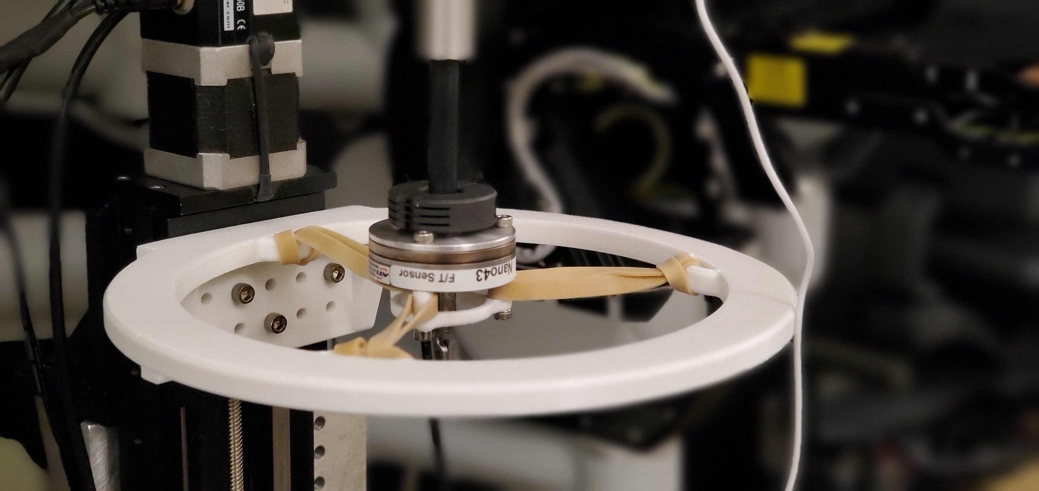
z
y
x

Slide 8
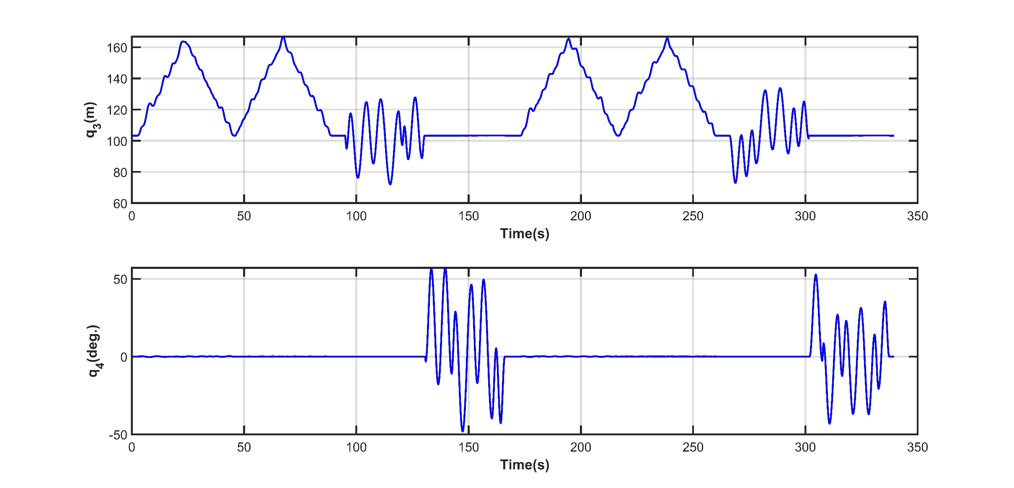
Calibration

Slide 9
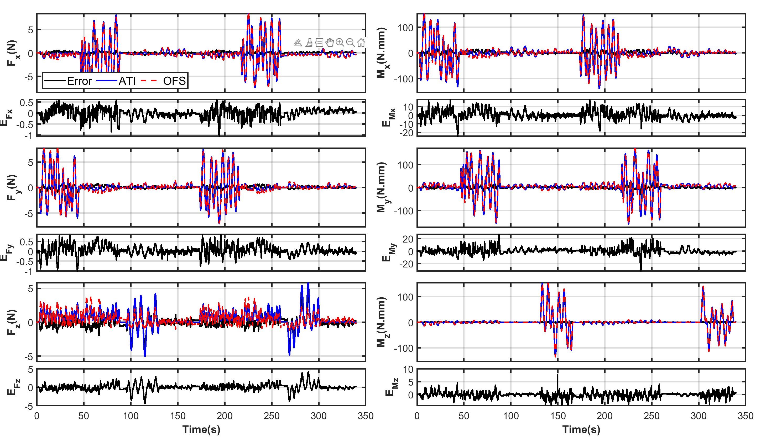
Calibration
Friction?

Slide 10
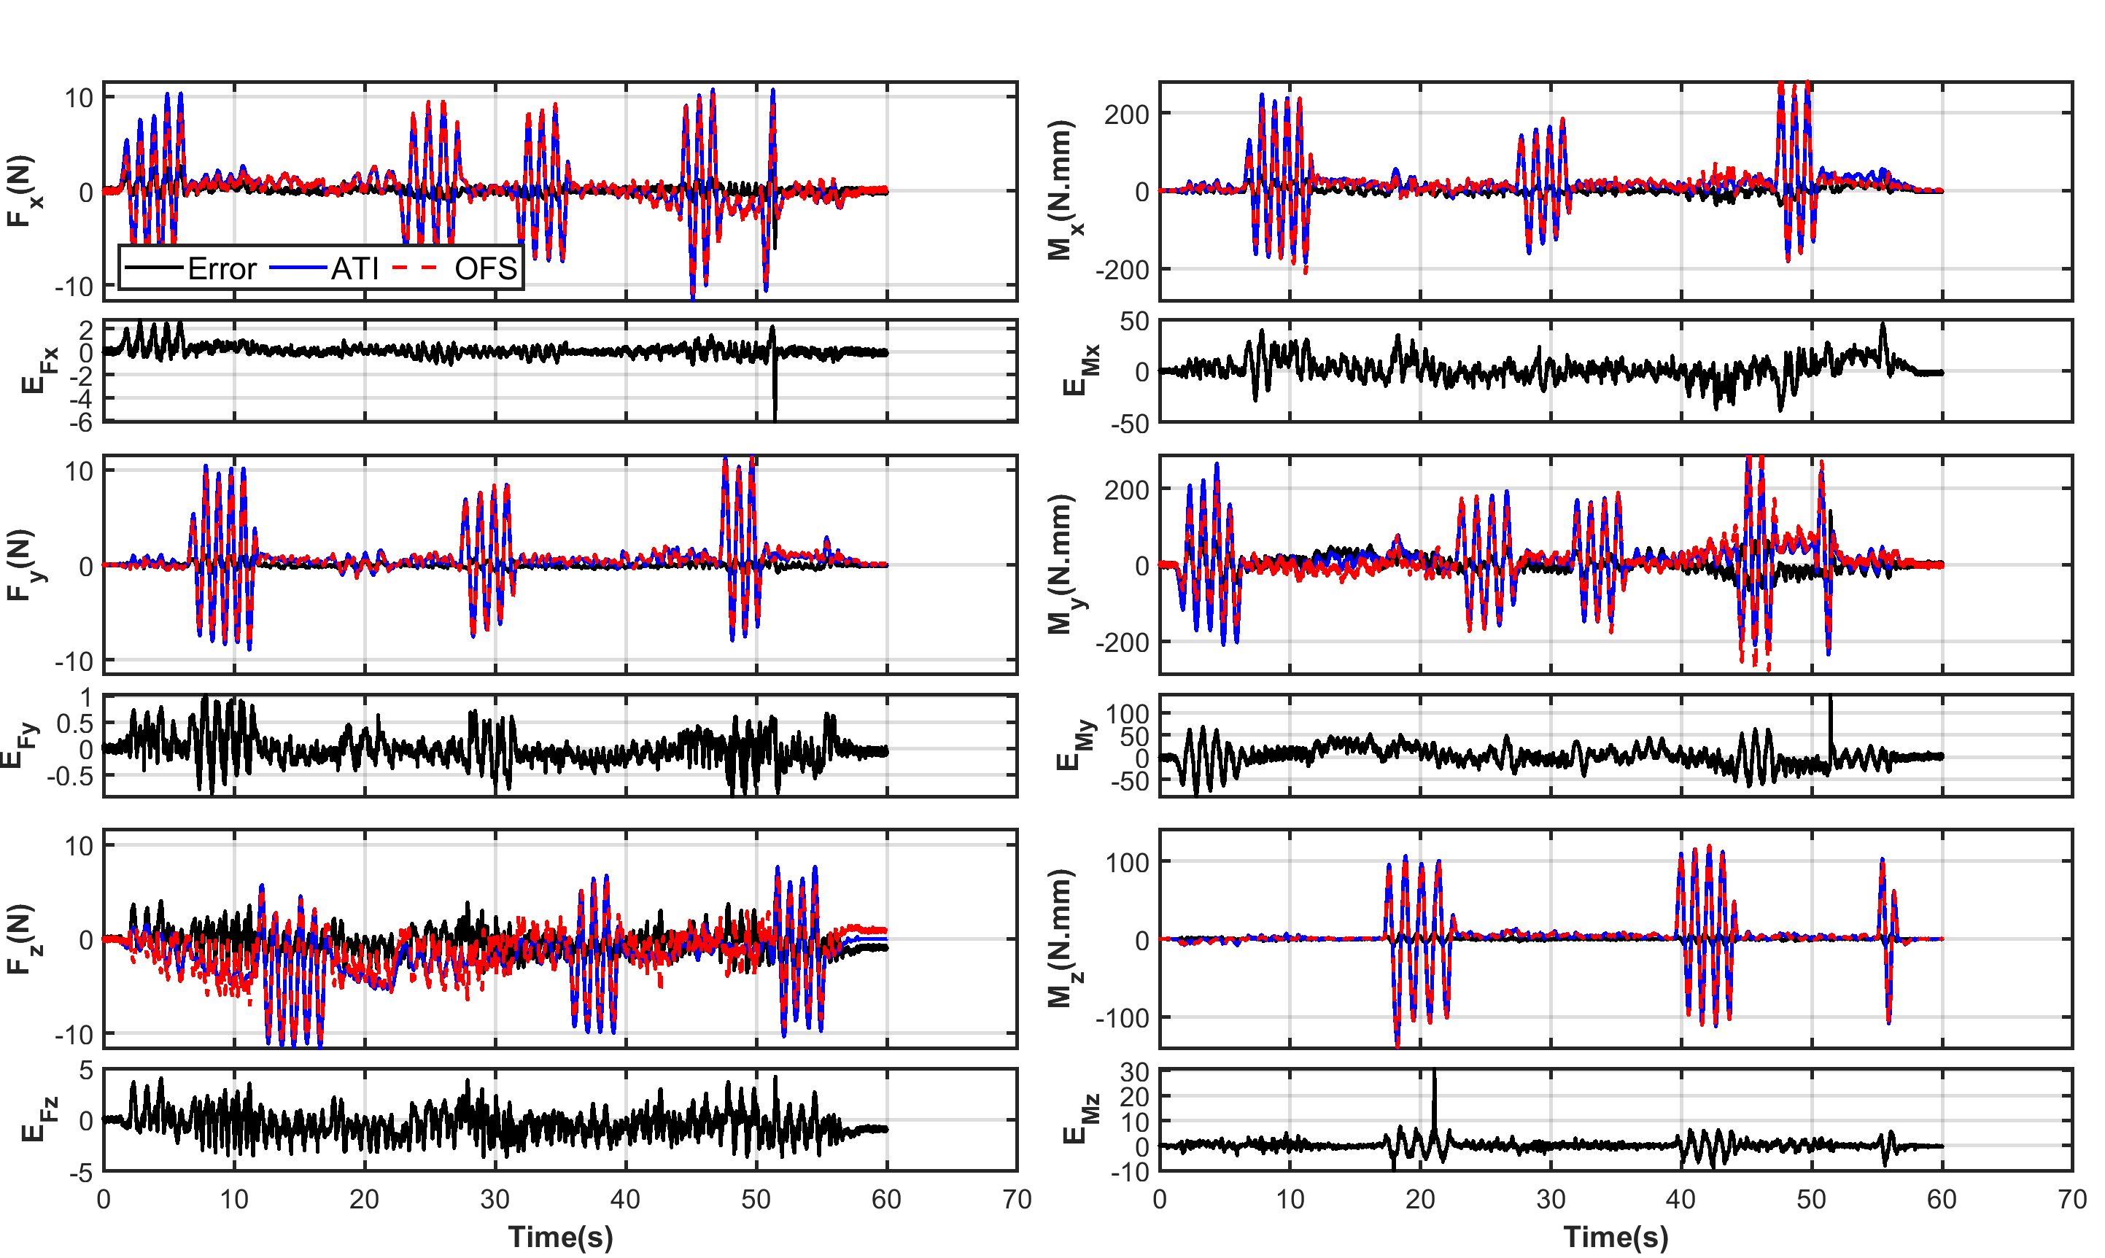
Calibration

Slide 11
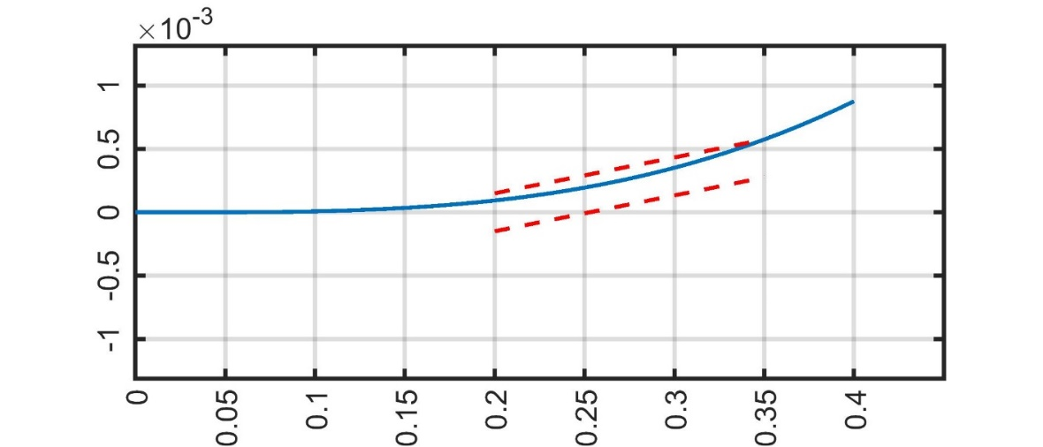
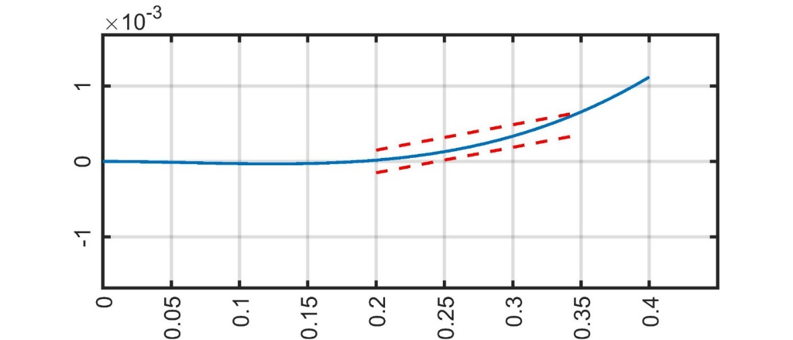
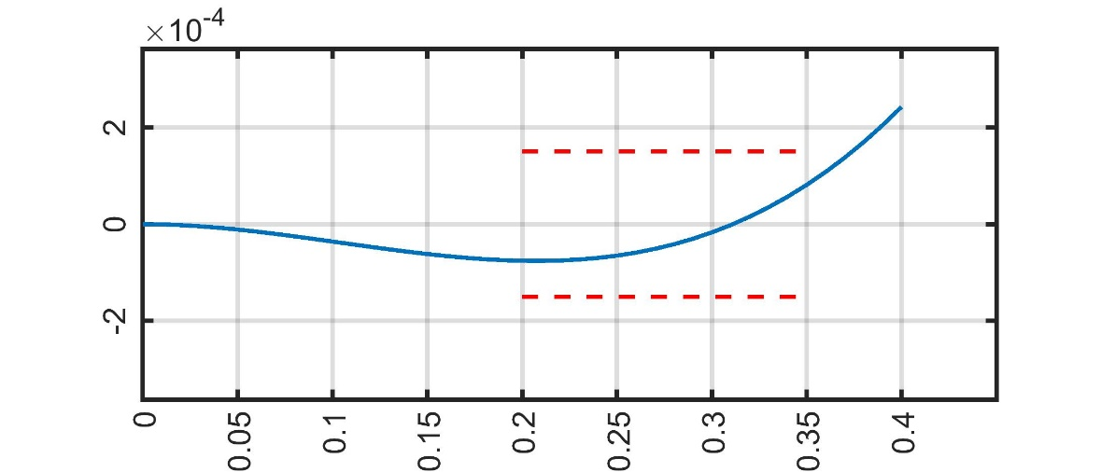
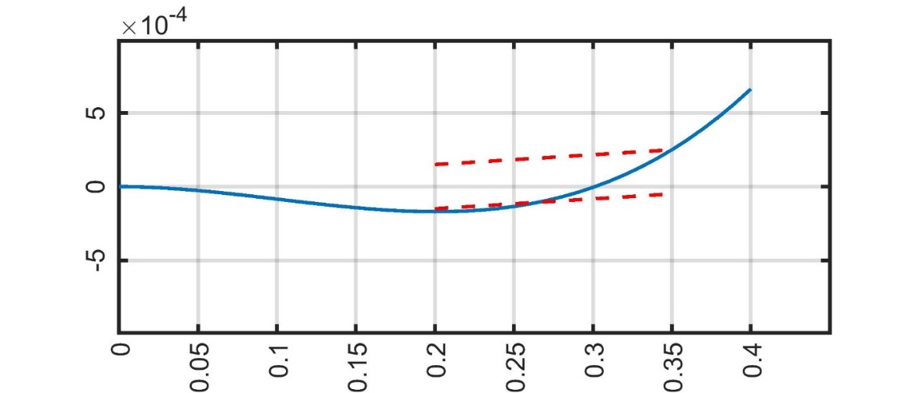
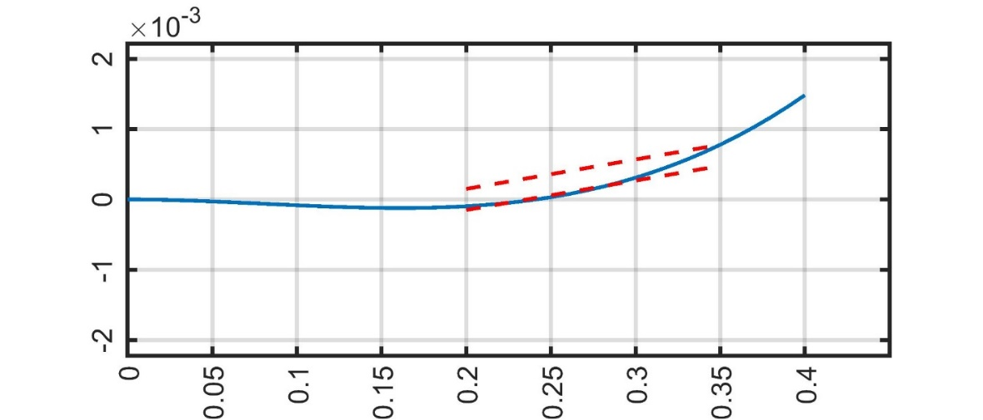
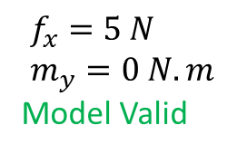
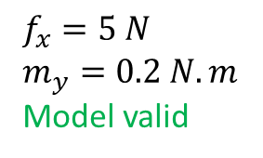
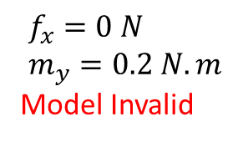
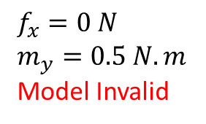

Limitations
$$f_{x}=5 N \\ m_{y}=0 N.m$$
Model Valid
$$f_{x}=5 N$$ $m_{y}=0.2 N.m$
Model valid
$$f_{x}=0 N \\ m_{y}=0.2 N.m$$
Model Invalid
$$f_{x}=0 N$$ $m_{y}=0.5 N.m$
Model Invalid
$$f_{x}=5 N \\ m_{y}=0.5 N.m$$
Model Invalid

Slide 12
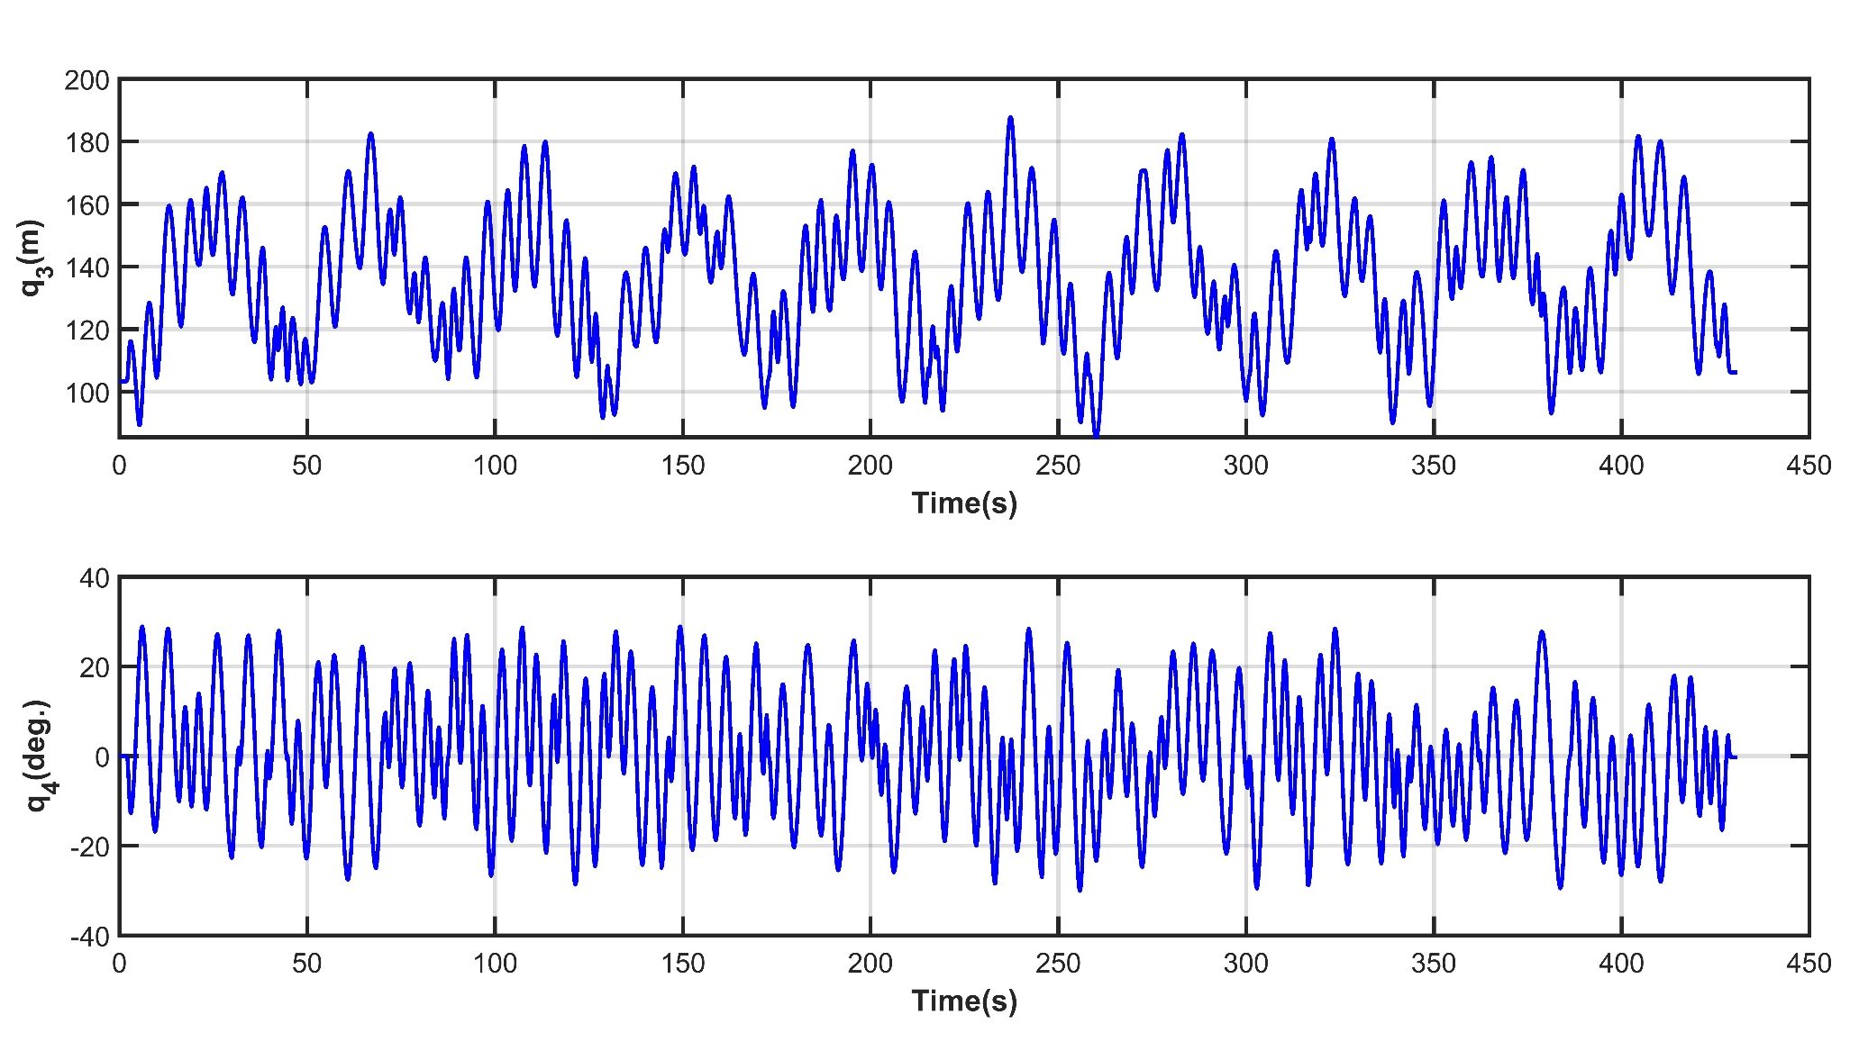
Neural Network Calibration
Reference sensor:
ATI Nano43 F/T
Data collection:
10 cycles during 7 minutes
Optimization tool:
MATLAB fitnet
Training set: first 6 cycles
Validation set: 6-8
Test set: 8-10

Slide 13
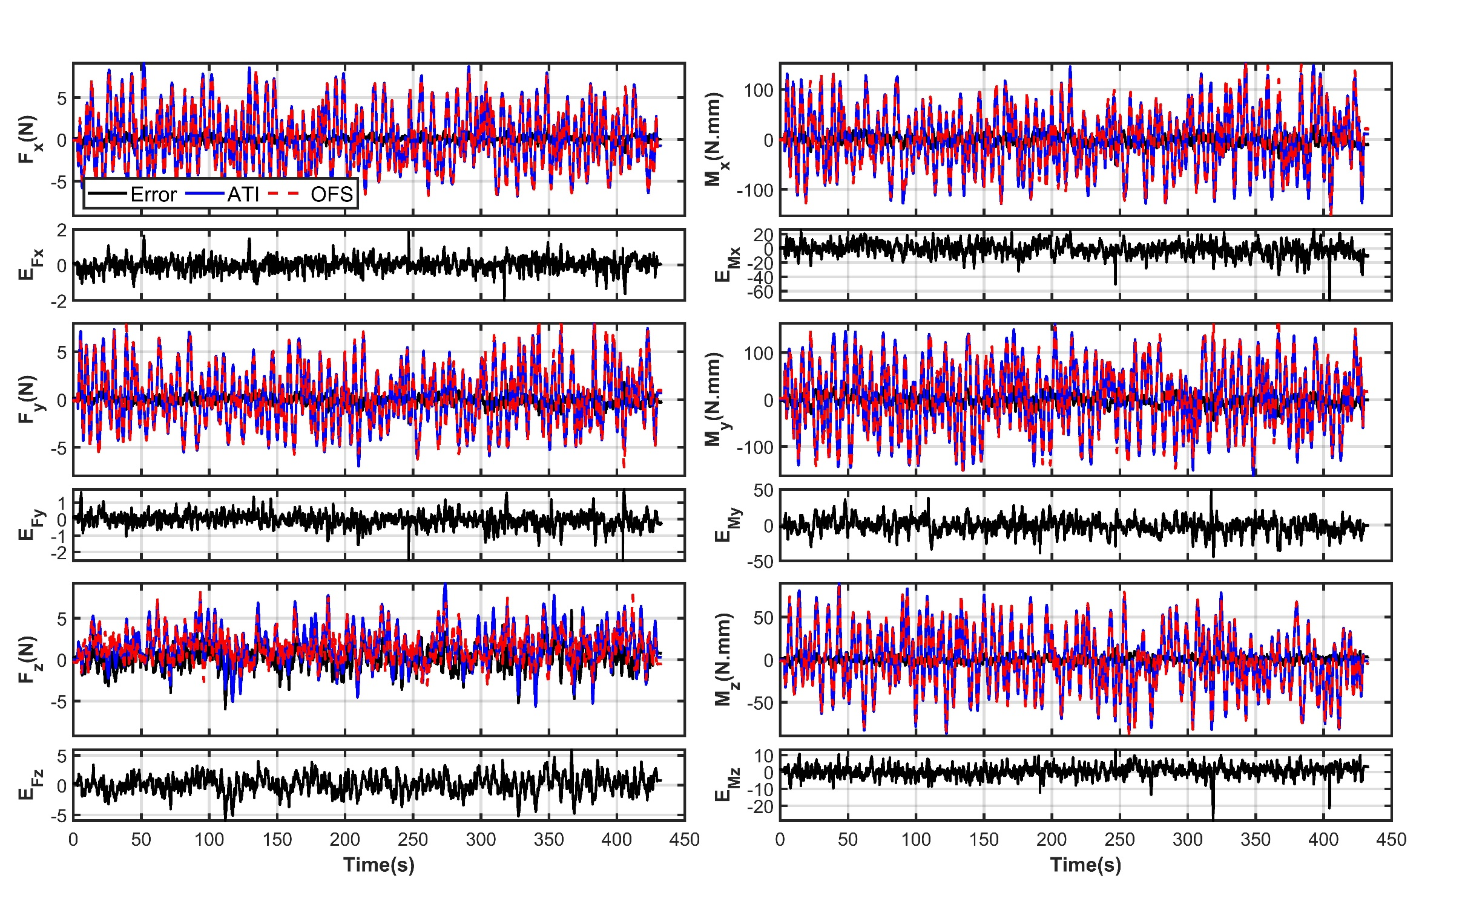
Neural Network Calibration

Slide 14
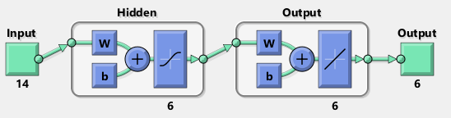
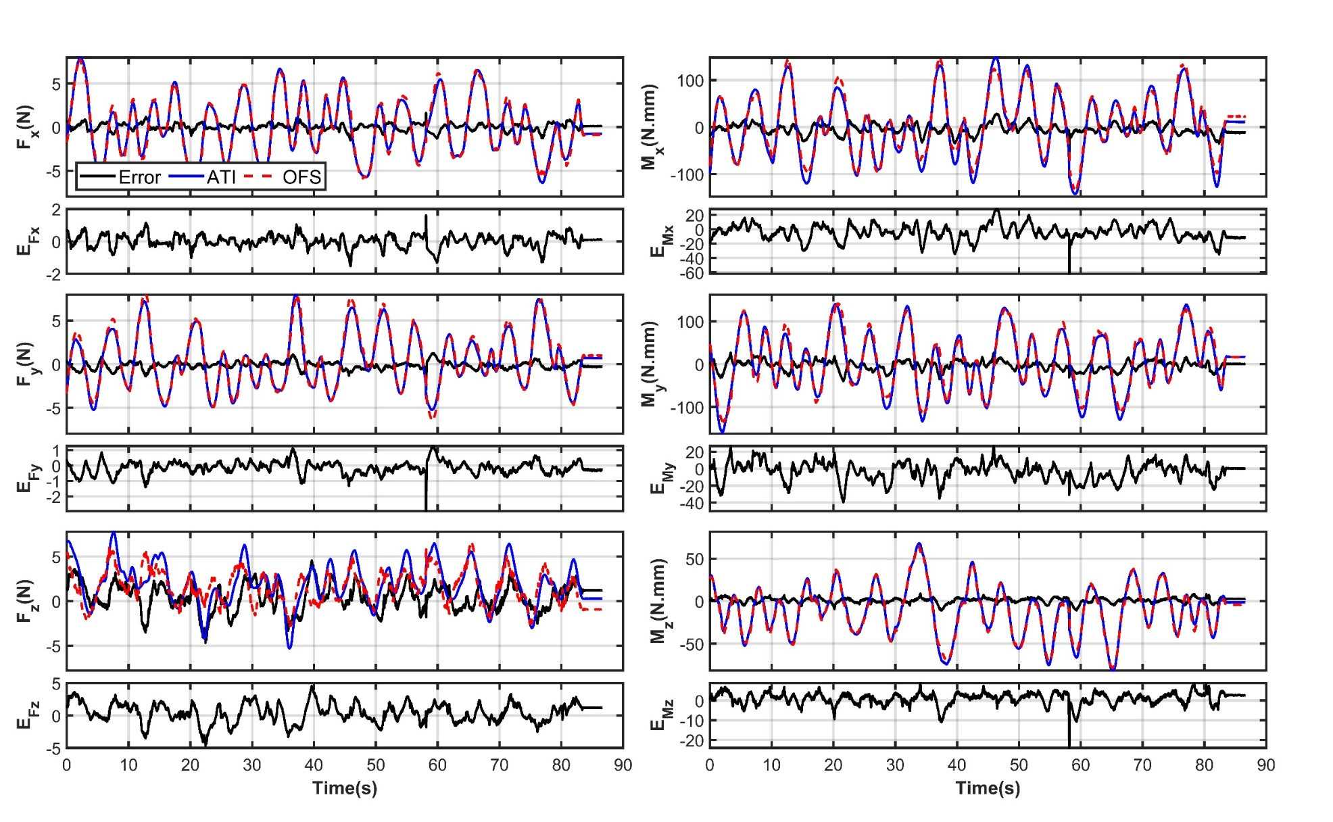
Neural Network Calibration
Training time < 10 s
Largest error in axial direction
It results in early stop of the training

Slide 15
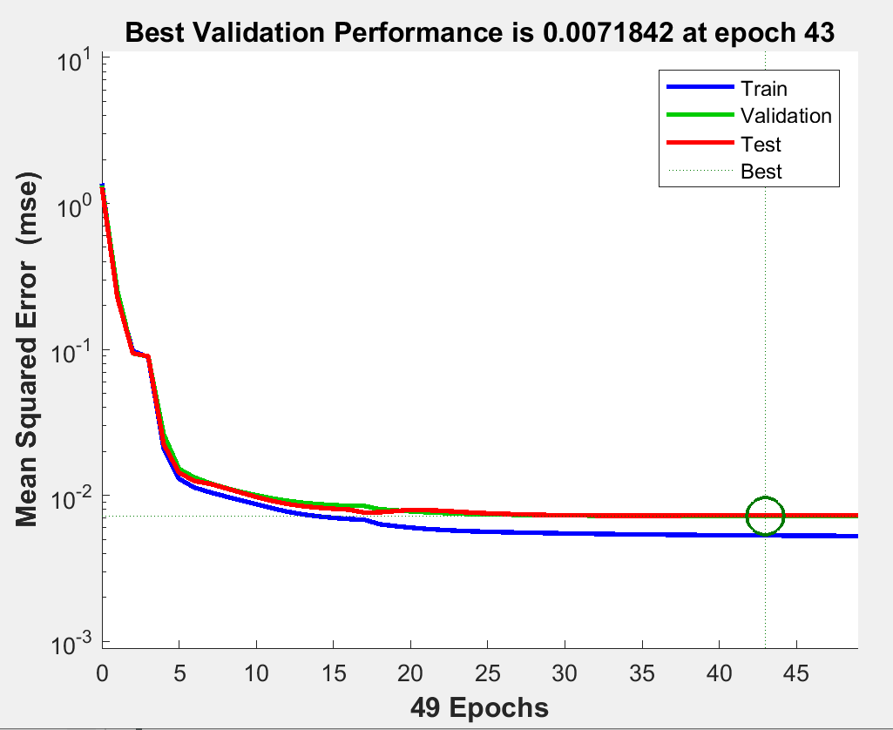
Neural Network Calibration

Slide 16
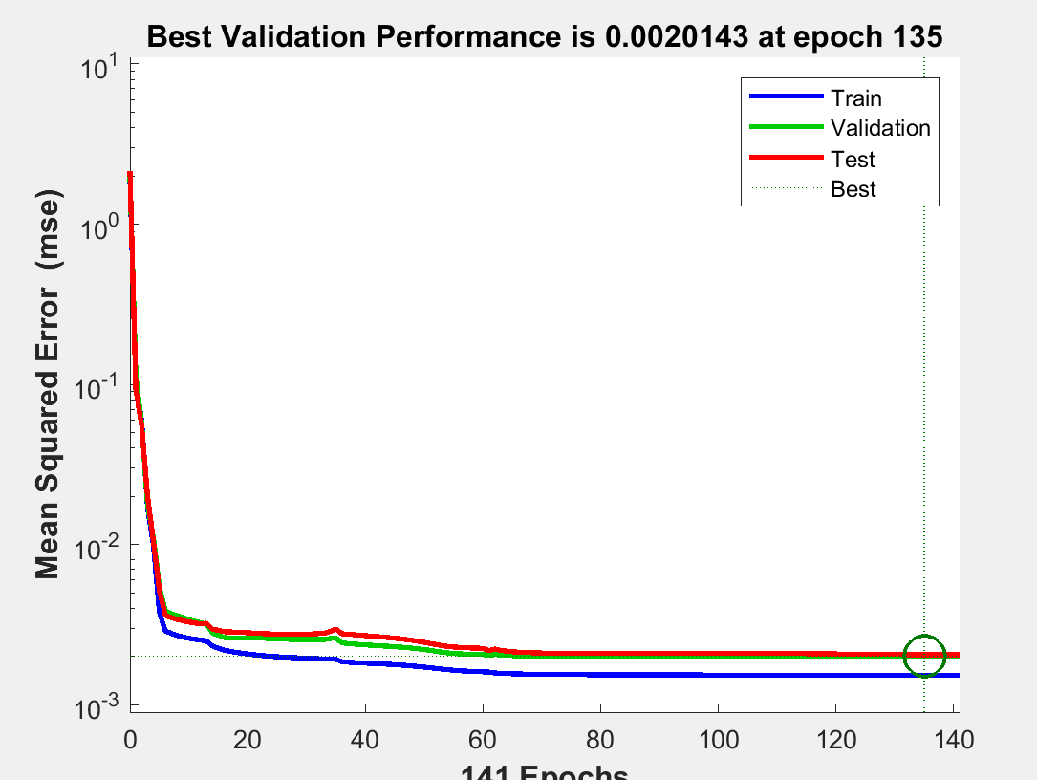
Neural Network Calibration (Fz removed)
Training time < 30 s

Slide 17
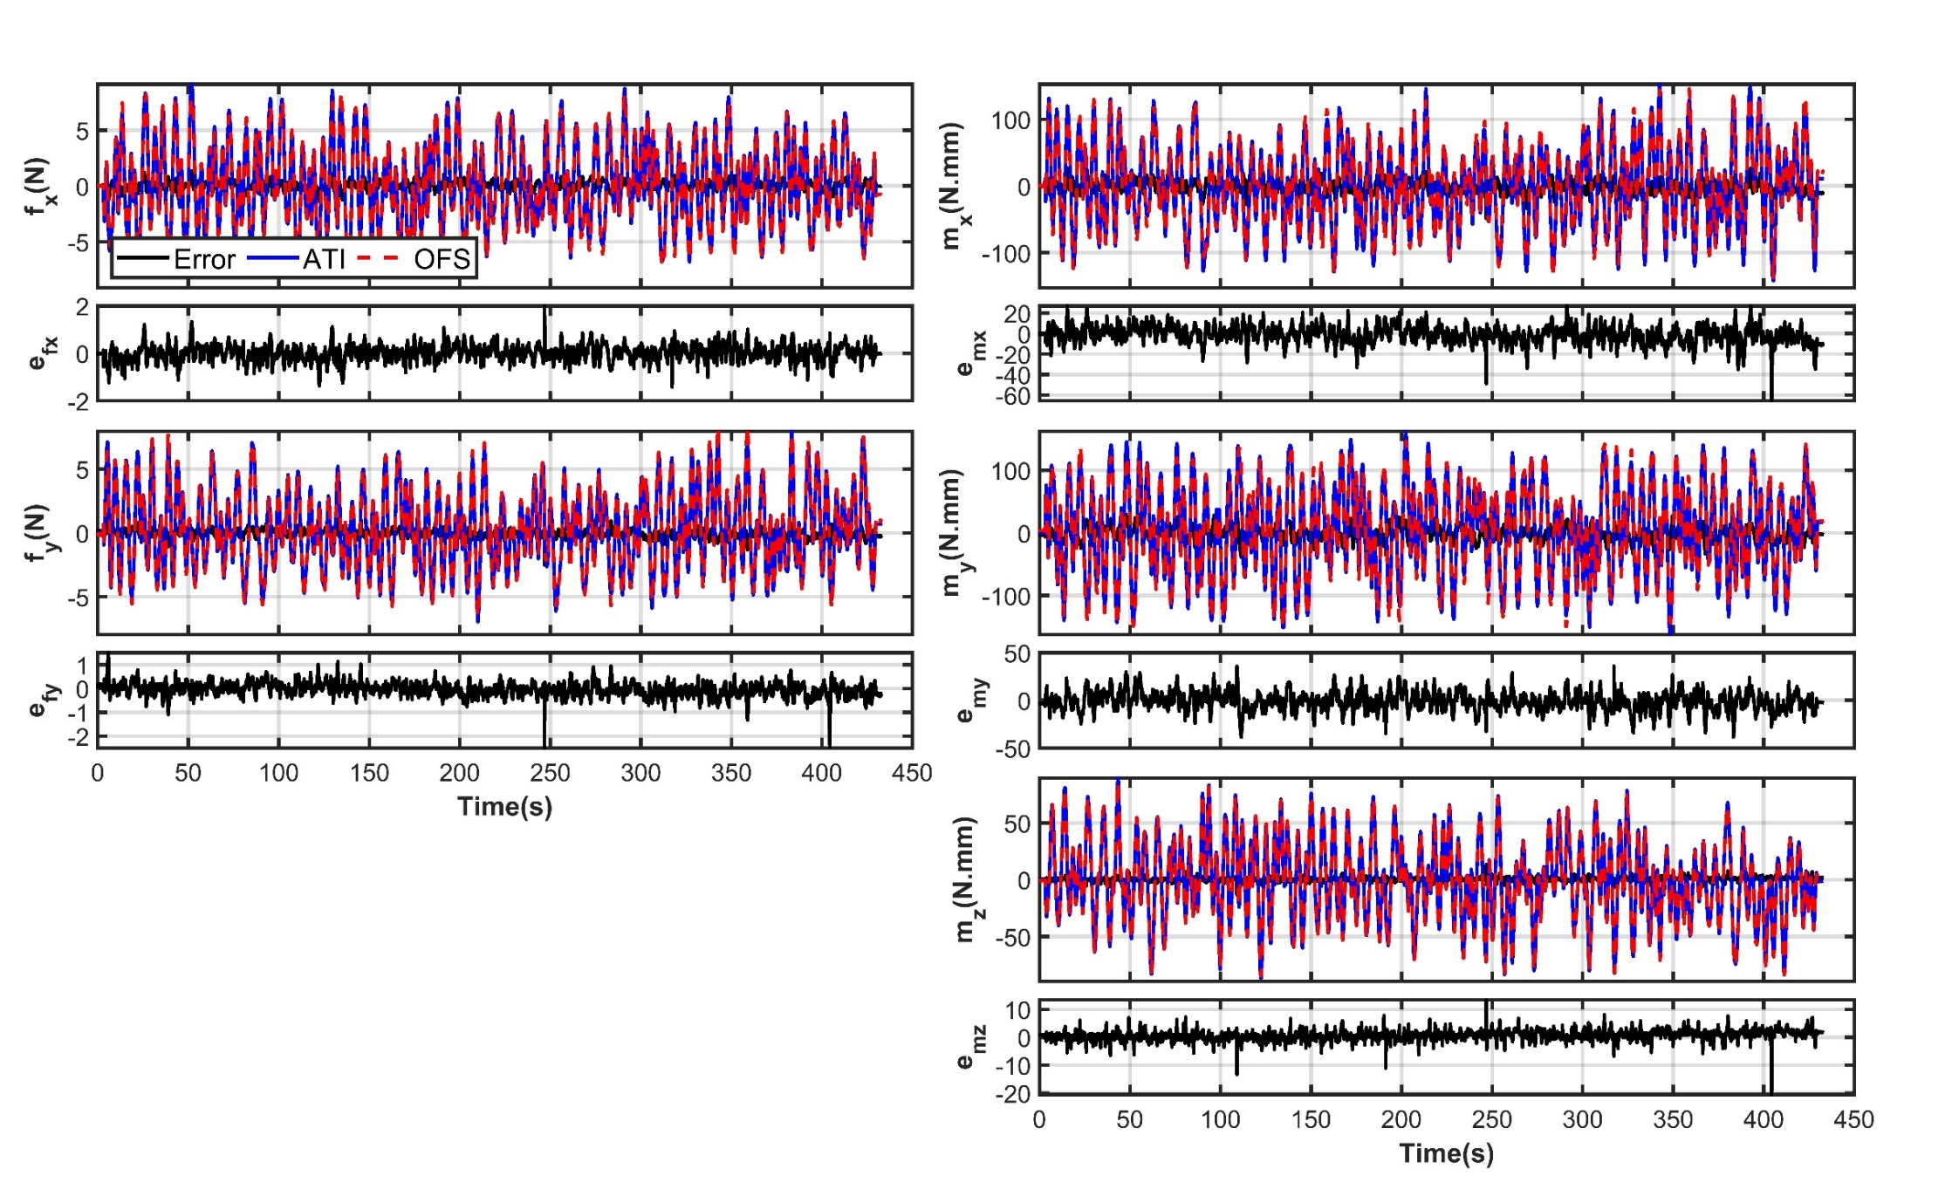
Neural Network Calibration (Fz removed)

Slide 18
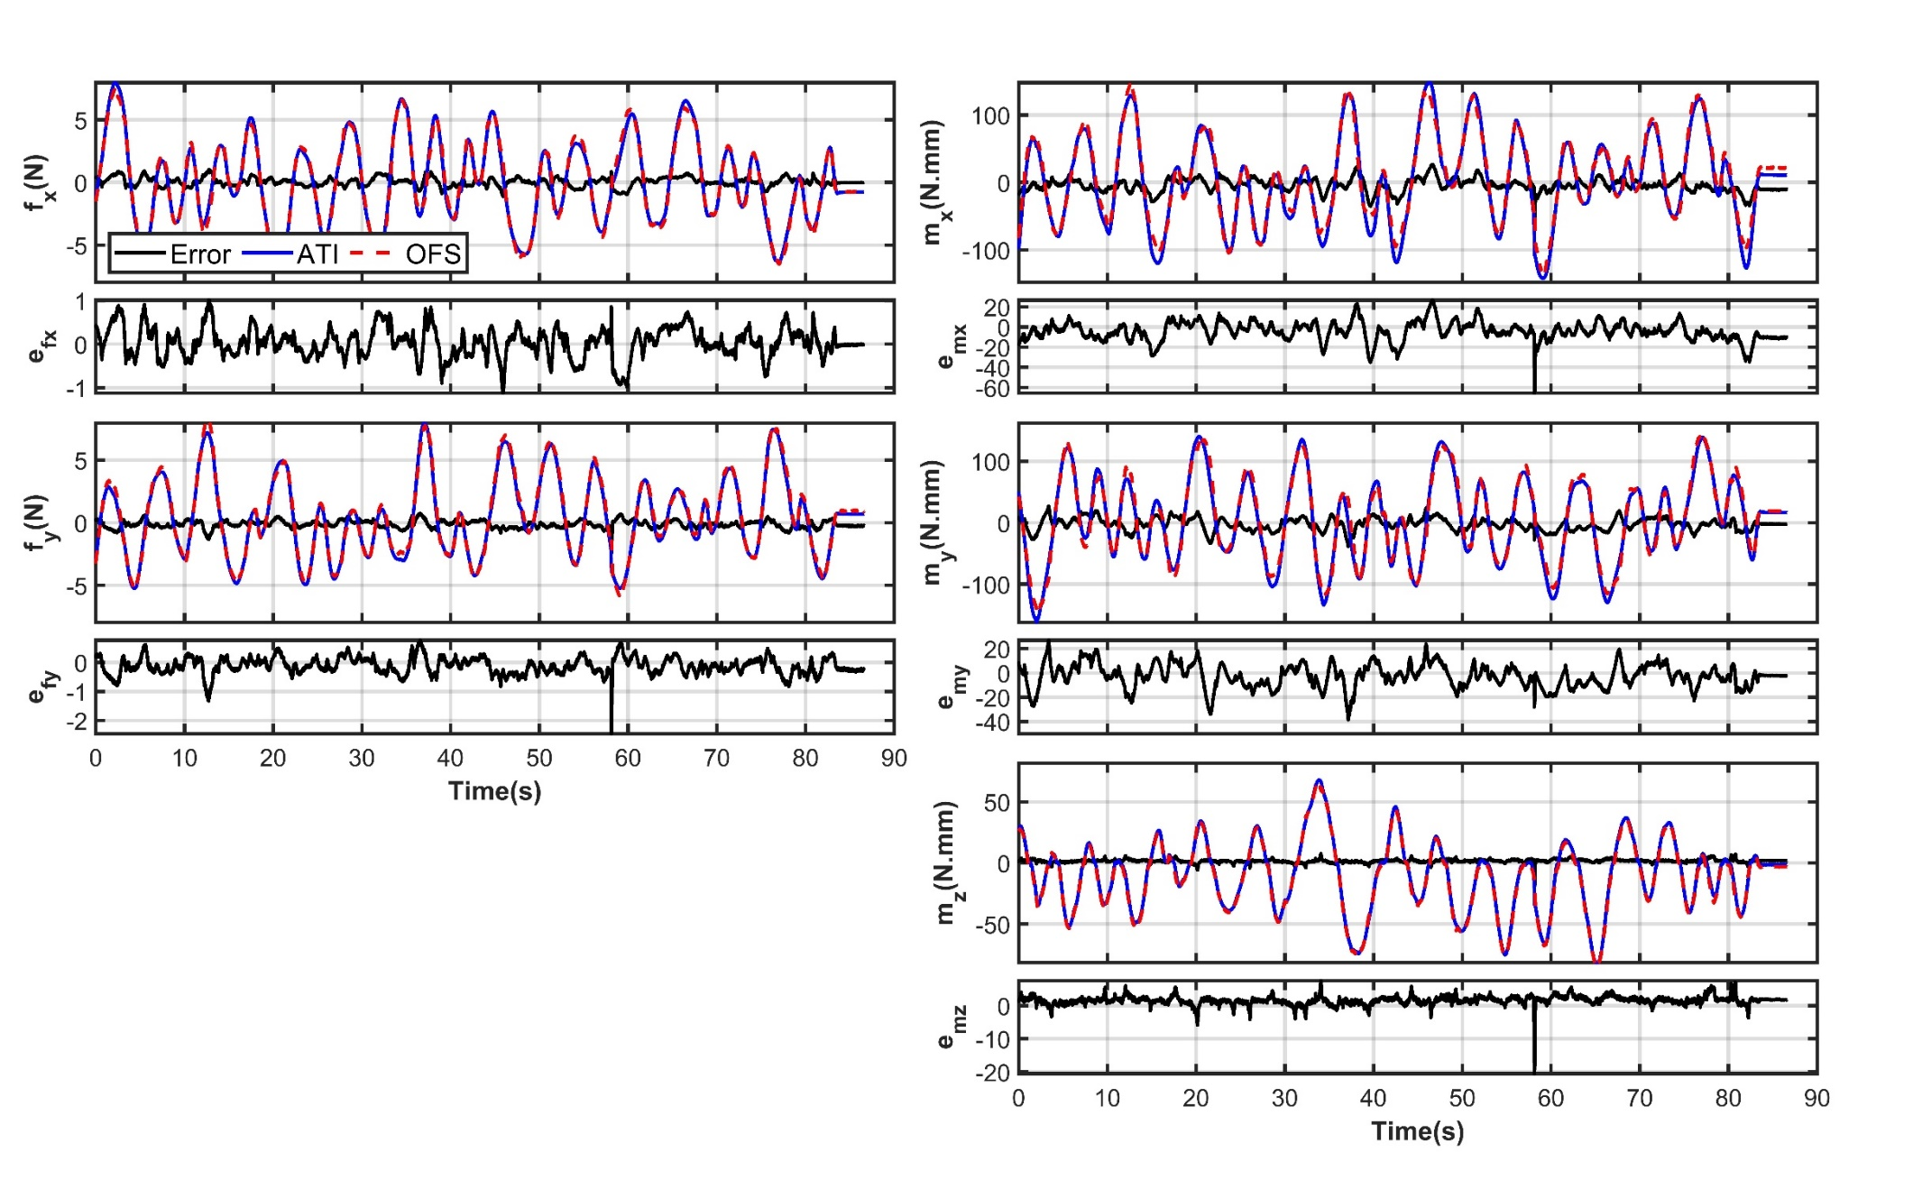
Neural Network Calibration (Fz removed)

Slide 19
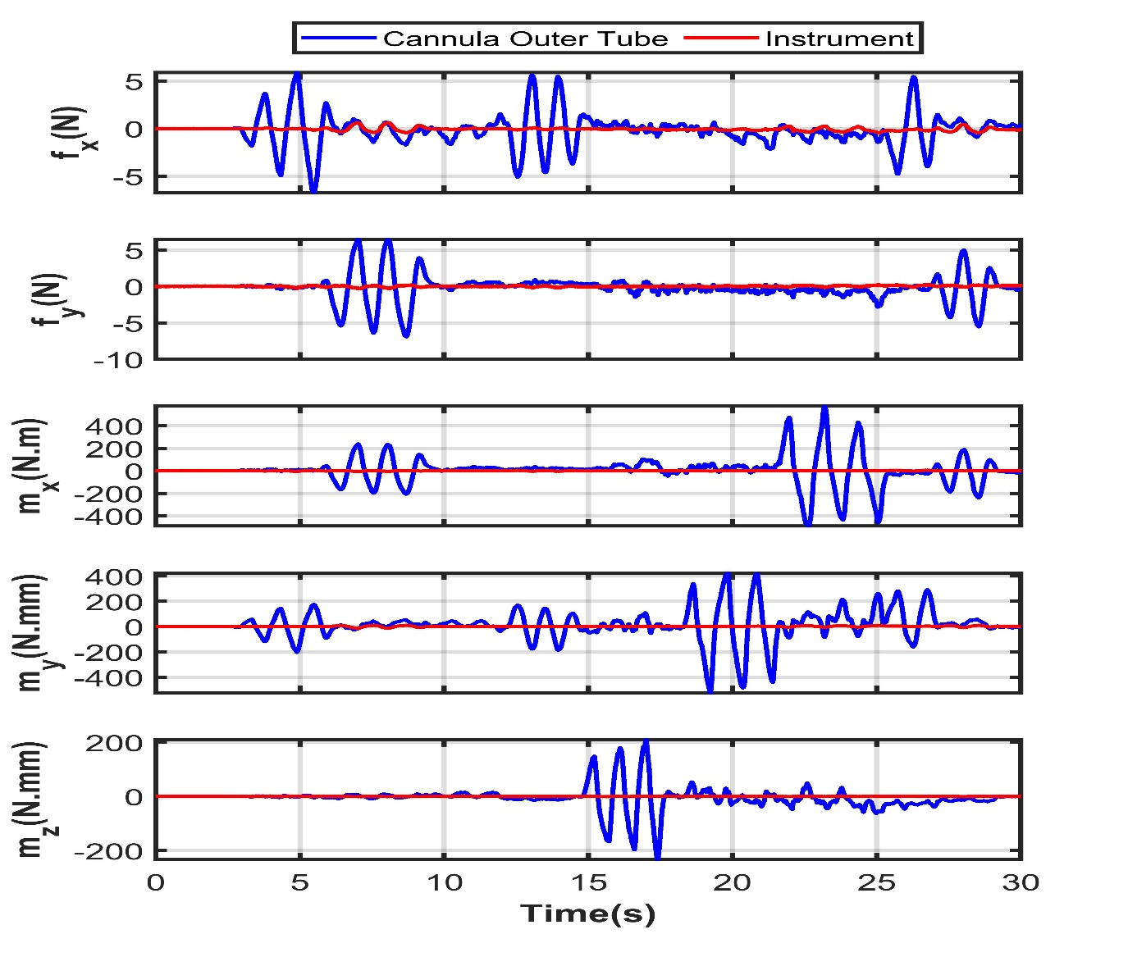
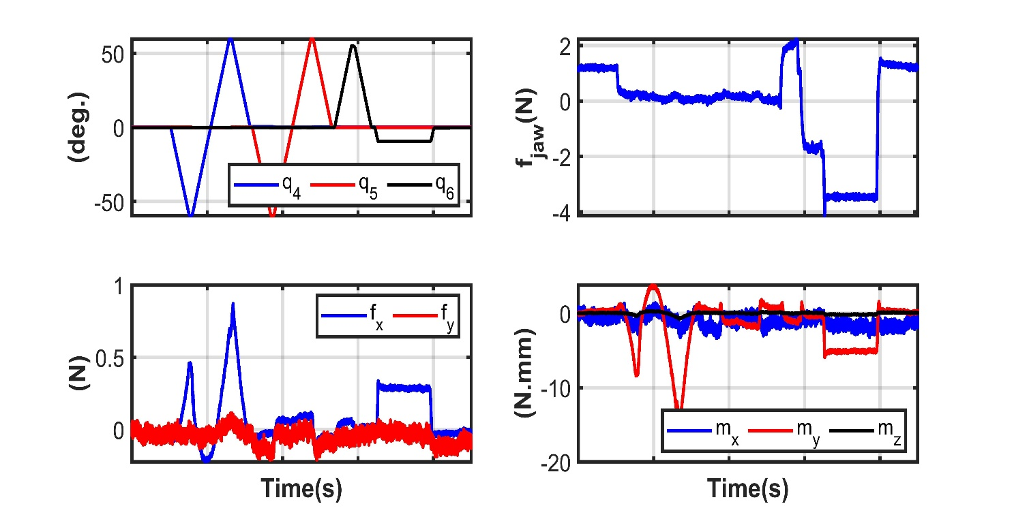
Overcoat Test
Wrist Maneuver

Slide 20
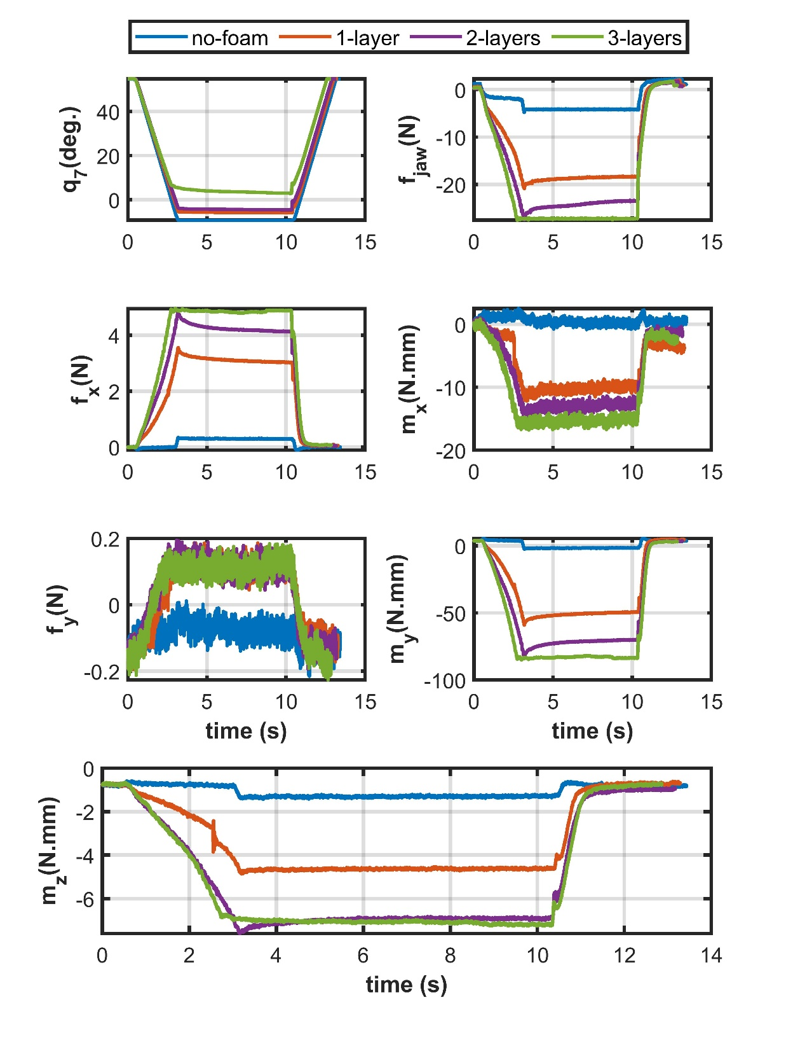
Pinch Test

Slide 21
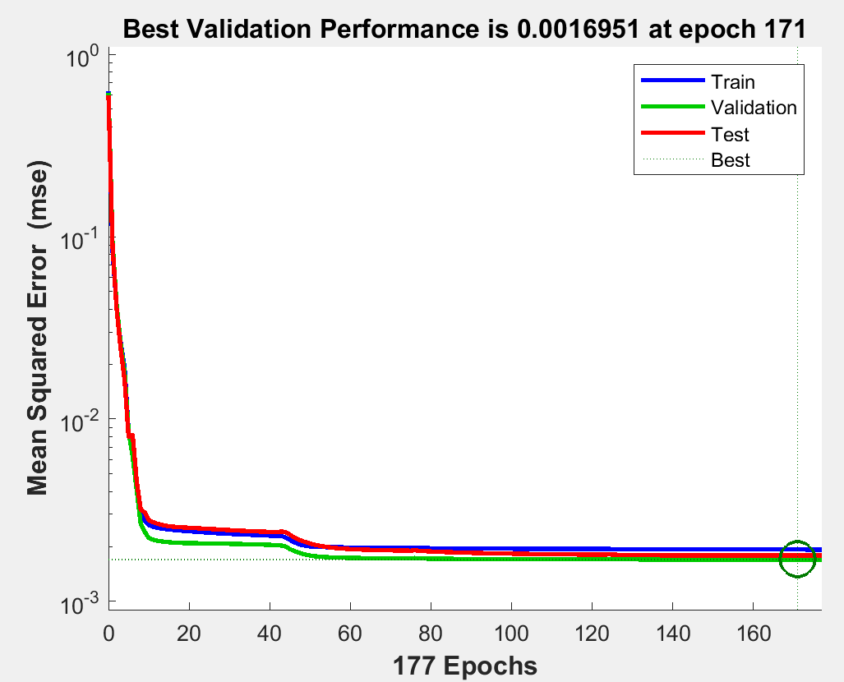
Neural Network Calibration (Fz removed, w Gripper Effort)

Slide 22
Neural Network Calibration (Fz removed, w Gripper Effort)
Training time < 30 s

Slide 23
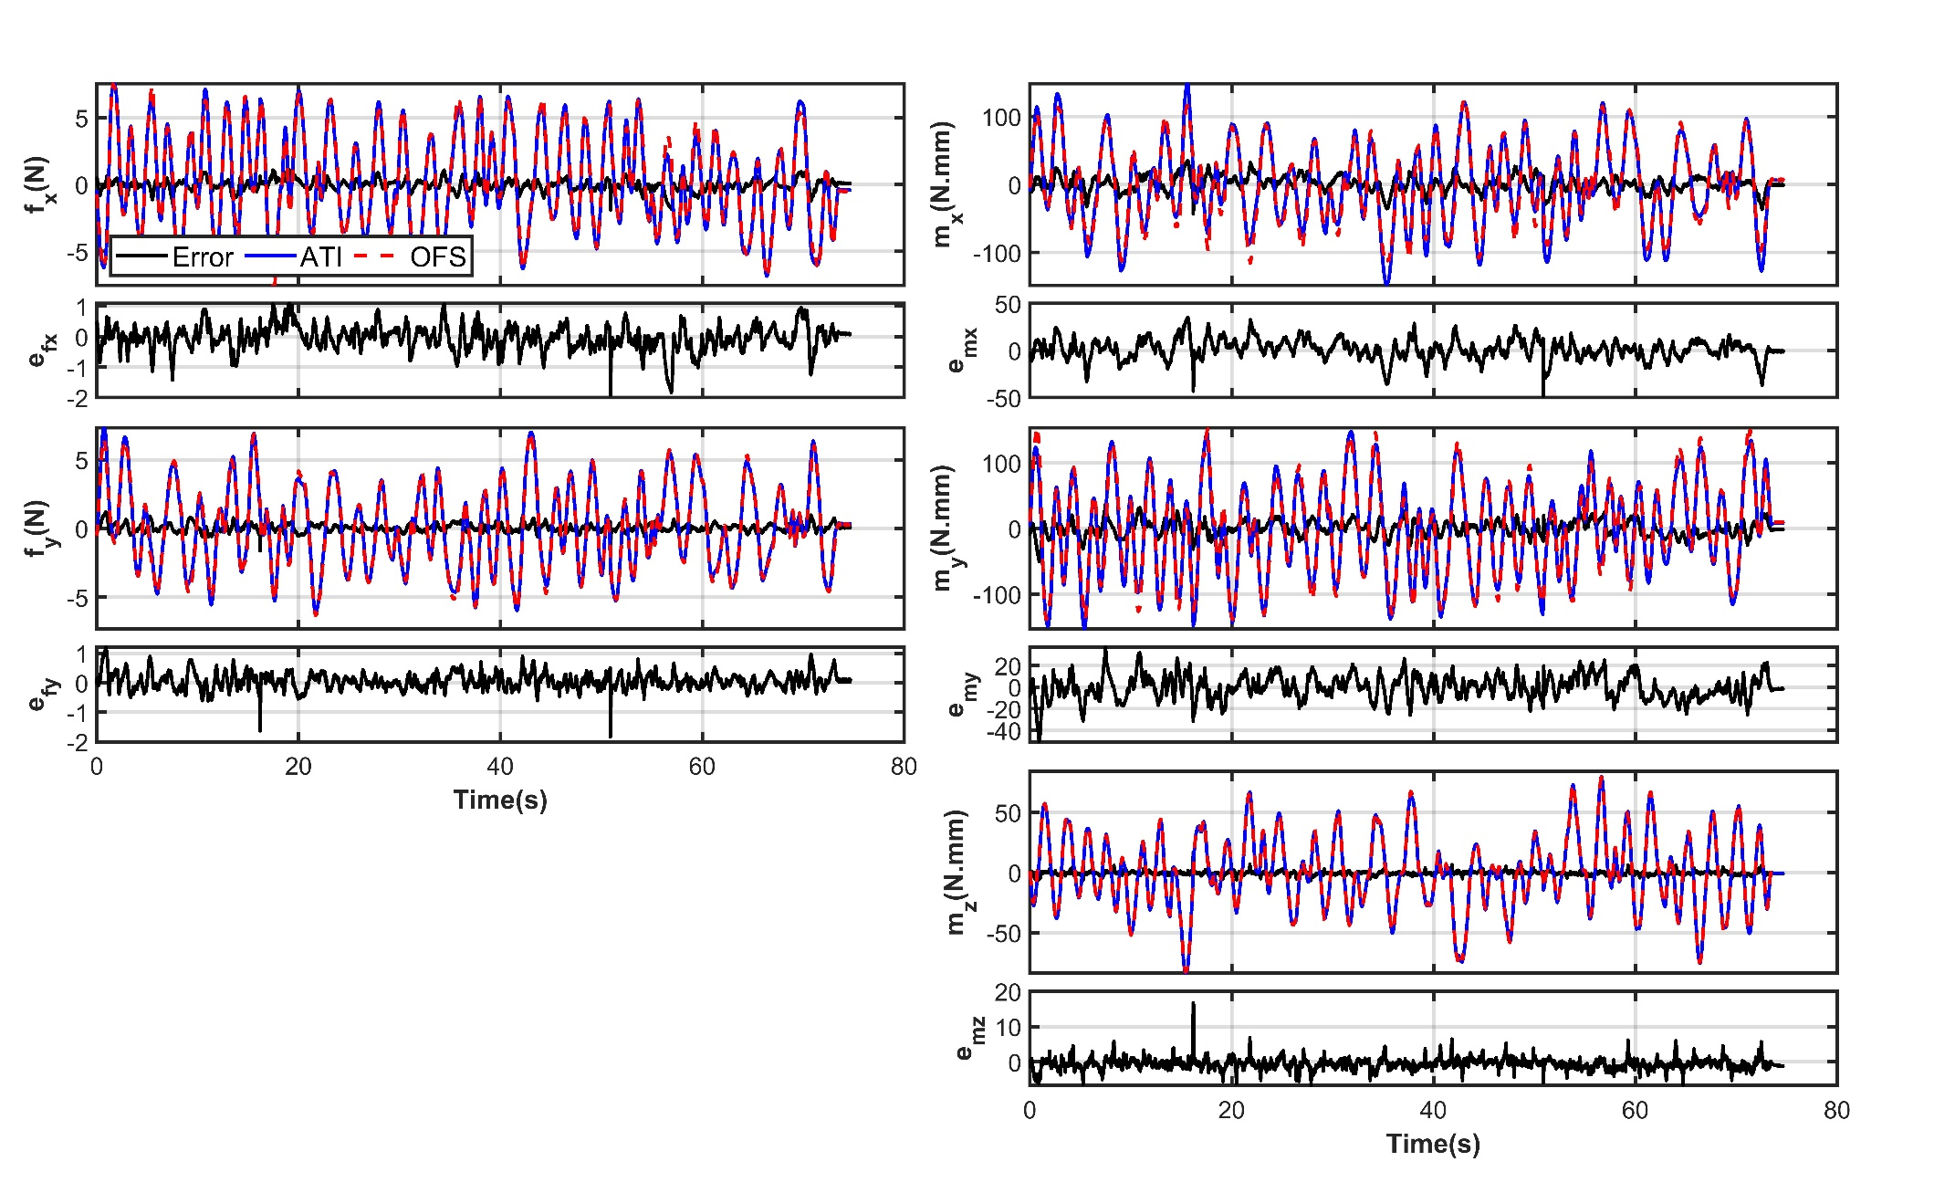
Neural Network Calibration (Fz removed, w Gripper Effort)

Slide 24
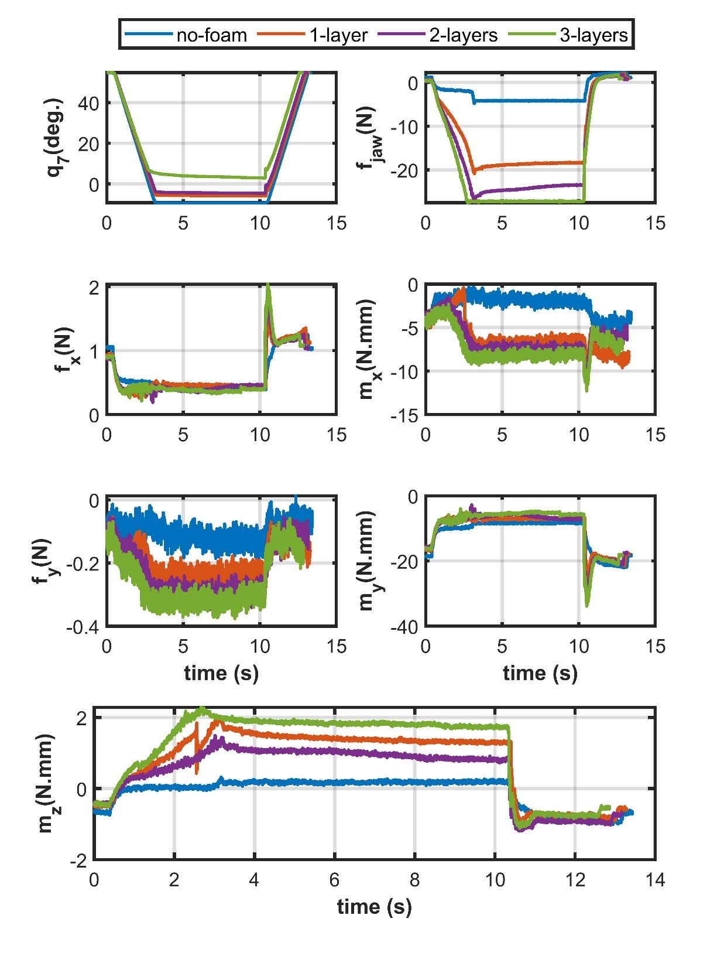
Pinch Test

Slide 25
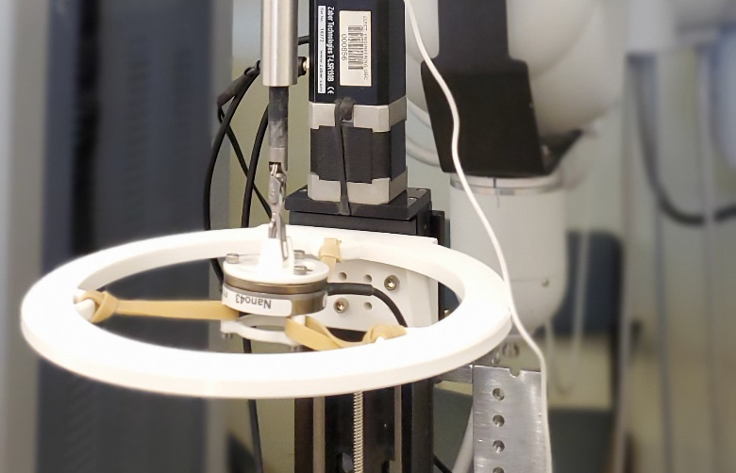
z
y
x

Slide 26
Reference sensor:
ATI Nano43 F/T
Data collection:
50 cycles during 70 minutes
Optimization tool:
MATLAB fitnet – Levenberg-Marquardt backpropagation
Networks Trained: categorized based on the inputs to the network
ndspe: normalized-difference-sum-position-effort
npe: normalized-position-effort
pe: position-effort
 |  | F |  | Train: 1-30 Val:31-40 Test:41-50 |  | S |  | Train: 1-10 Val:11-15 Test:45-50
Layers |  | (10-5)-5 |  |  |  | (10-5)-5
Model | # Weights | Training Err. | Validation Err. |  | time (s) | Training Err. | Validation Err. |  | time (s)
NDSPE | 475 | 0.0019 | 0.0026 |  | 98it, 3:23 | 0.0017 | 0.0039 |  | 37it, 00:36
NPE | 355 | 0.0019 | 0.0026 |  | 124it, 2:48 | 0.0017 | 0.0037 |  | 63it, 00:40
PE | 235 | 0.0025 | 0.0032 |  | 82it, 1:09 | 0.0022 | 0.0037 |  | 102it, 00:42

Slide 27
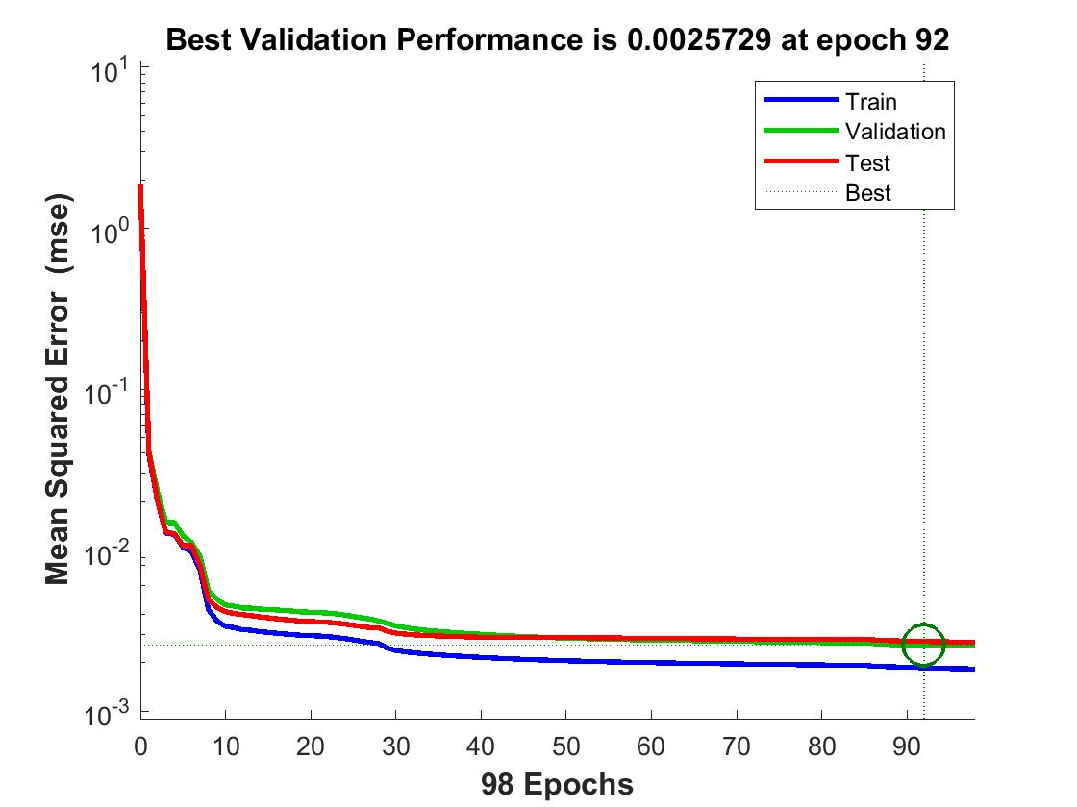
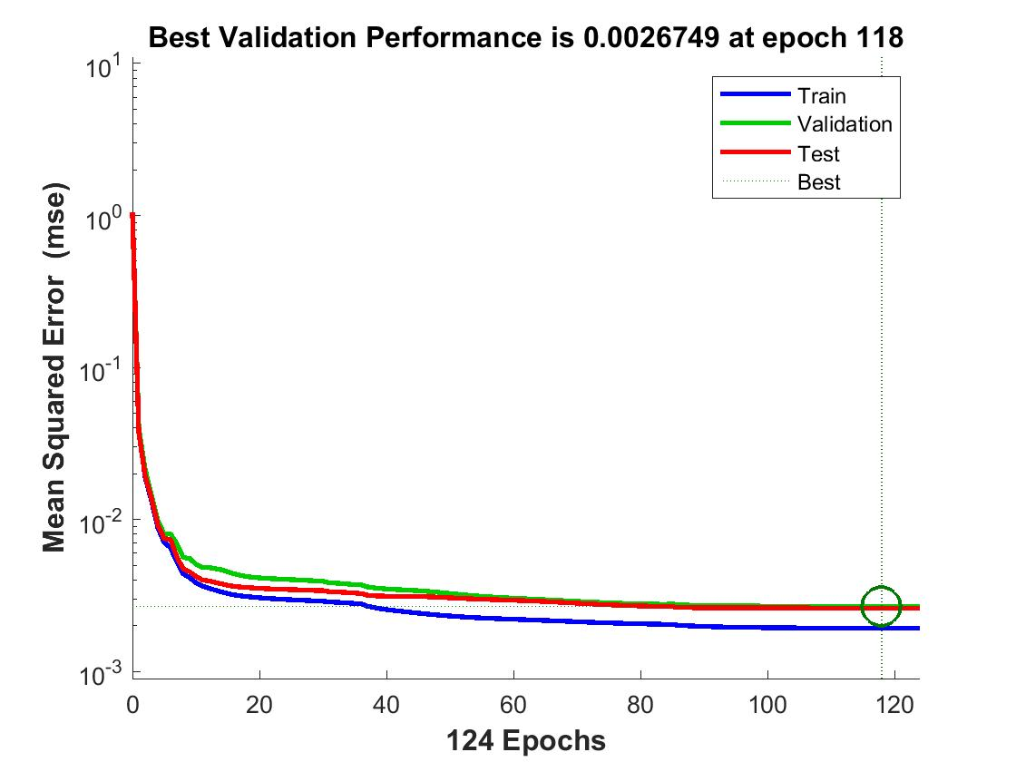
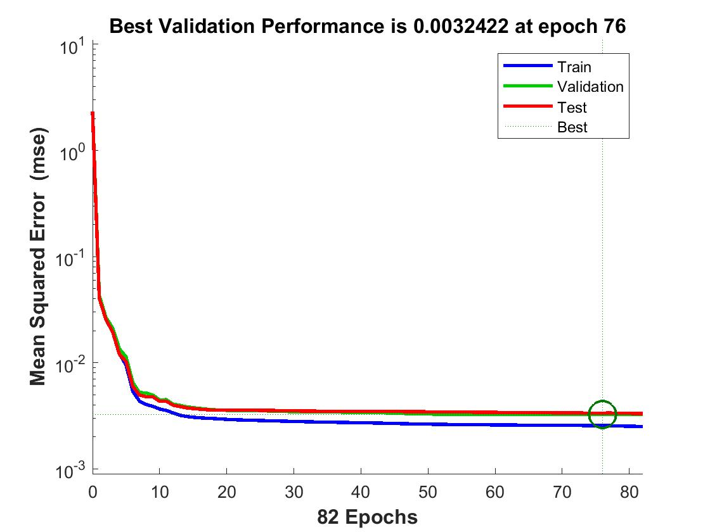
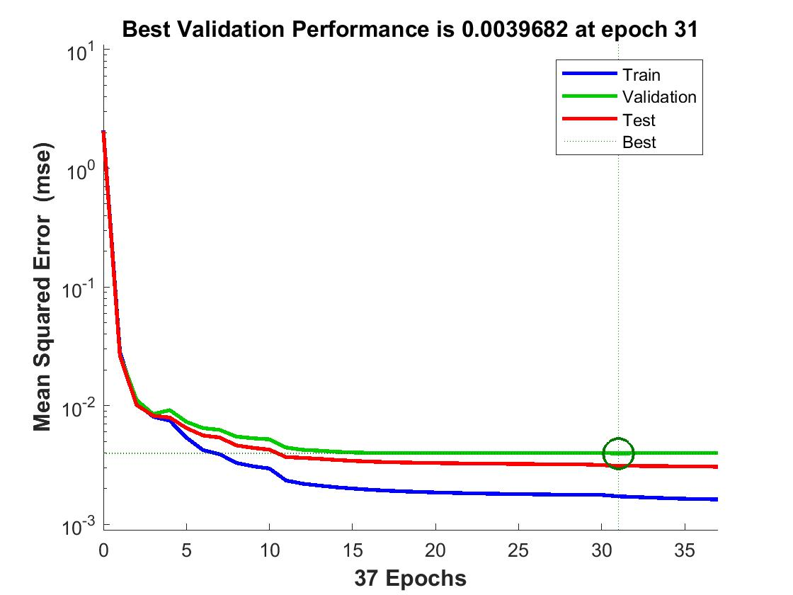
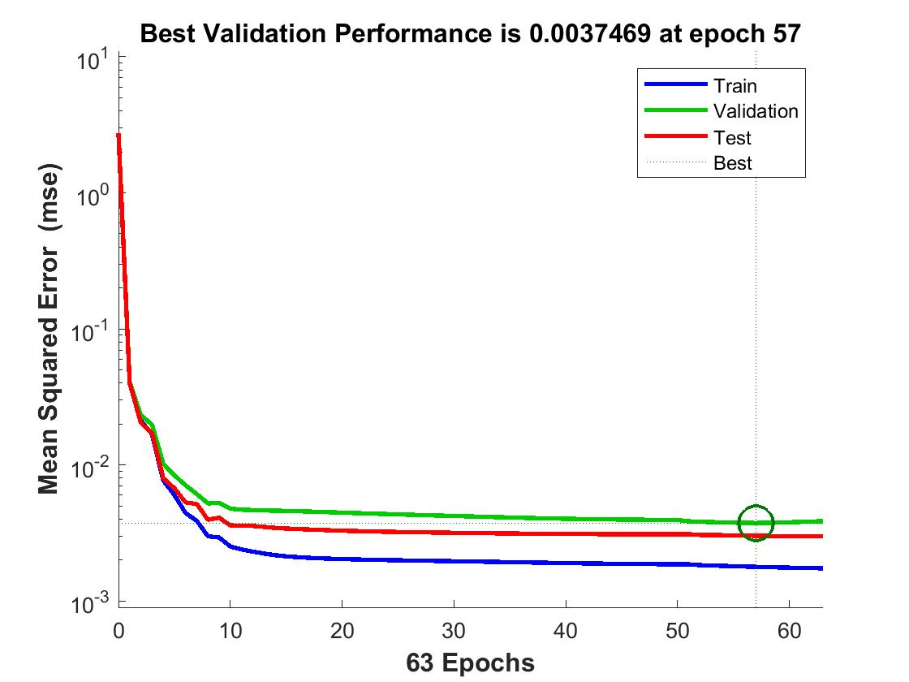
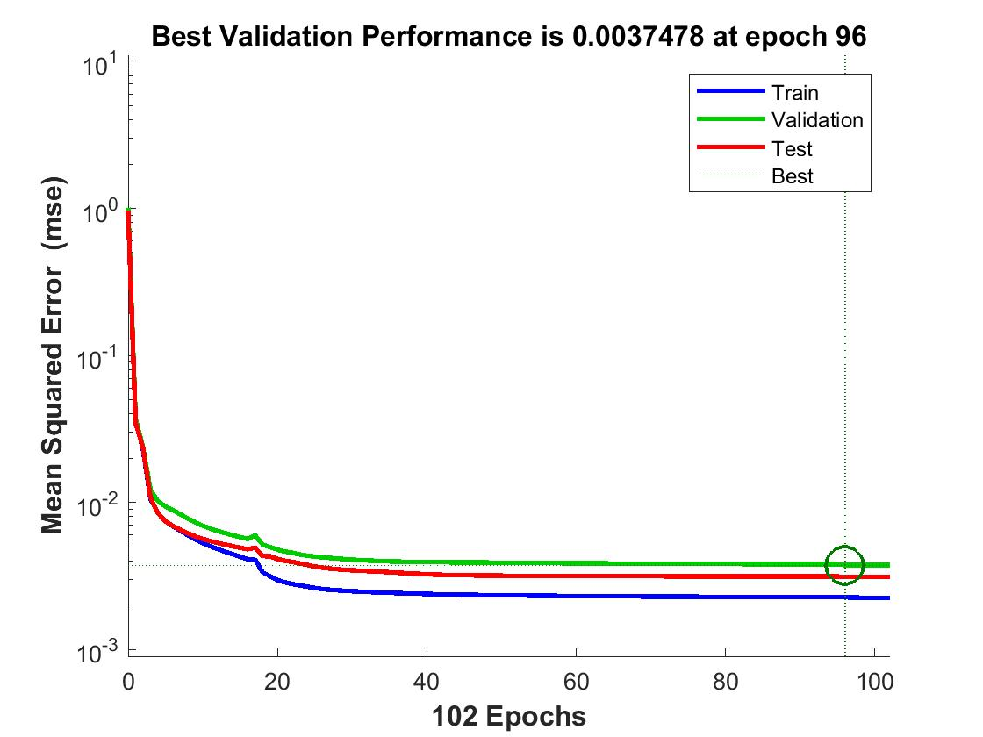
NDSPE-F
NPE-F
PE-F
NDSPE-S
NPE-S
PE-S

Slide 28
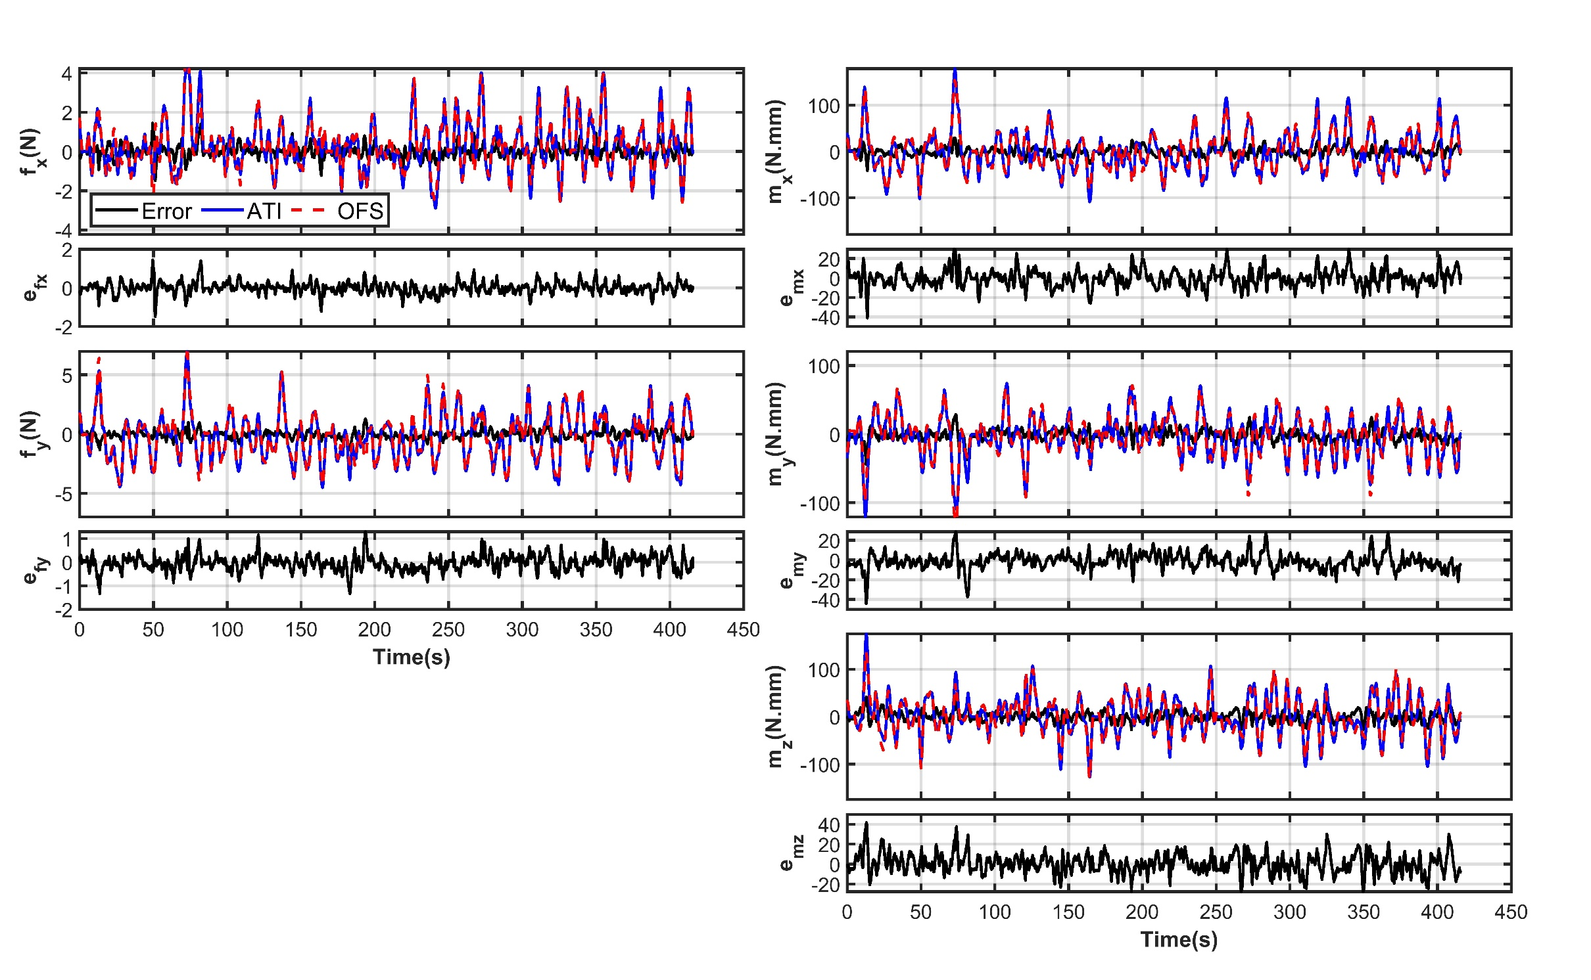
NPE-F

Slide 29
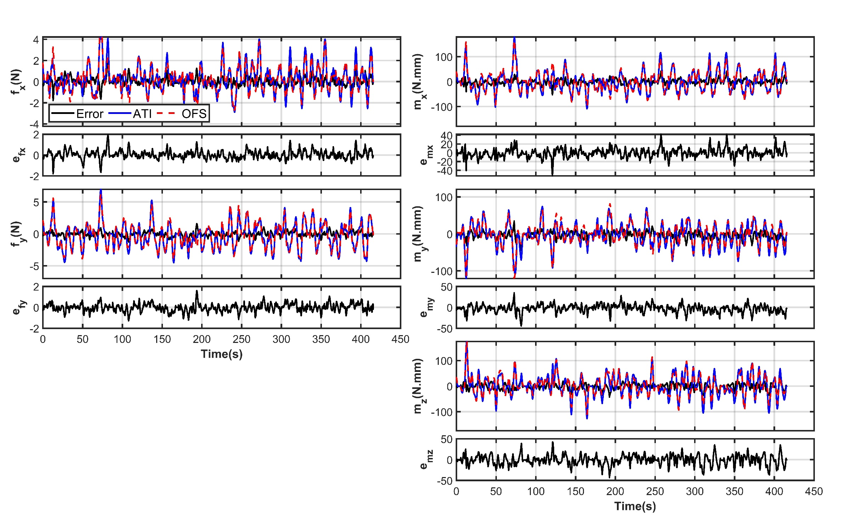
PE-S

